Slide 1
Pocket PL:
Adaptive Teaching
A research-informed framework for planning and responding to learner variability.

Slide 2

Learning Intentions
Explain adaptive teaching.
Apply the ADAPTS framework when planning and teaching.
Select adaptive strategies that maintain ambitious learning.

Slide 3
The Challenge
Every classroom contains learner variability.
The challenge isn't whether we adapt.
The challenge is how we adapt without lowering expectations.
Prior knowledge
Vocabulary
Working memory
Attention
Confidence
Language proficiency
Processing speed
Language proficiency
Motivation
Misconceptions

Slide 4
What is Adaptive Teaching?
Adaptive teaching is an evidence-informed approach to instruction that maintains high expectations for every learner by anticipating barriers to learning, responding purposefully to evidence during teaching, and adapting support so all students can access ambitious learning and become increasingly independent.
Notes:
Gina Davies Definition

Slide 5

Adaptive teaching means...
Maintaining common ambitious learning goals.
Anticipating barriers.
Planning appropriate support.
Responding to evidence.
Gradually removing support.

Slide 6
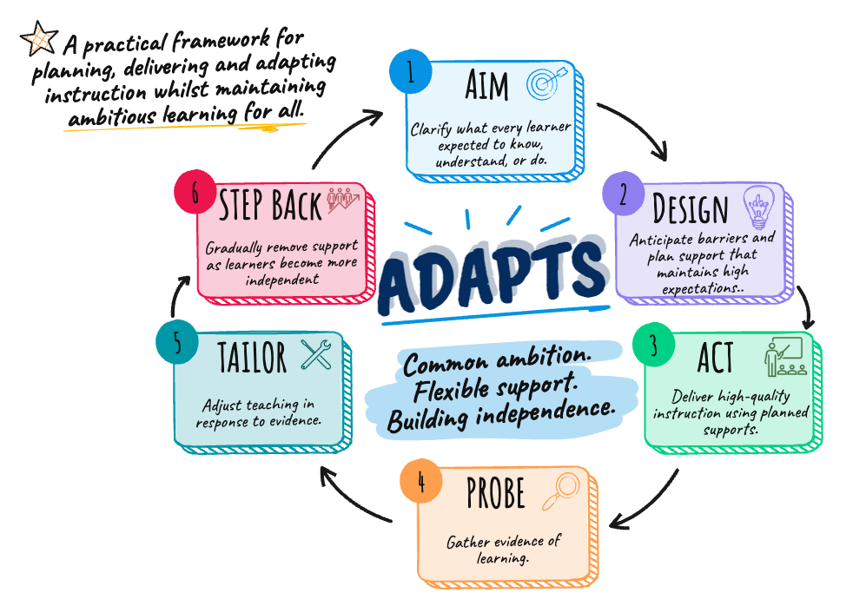
The ADAPTS Framework for Adaptive Teaching
Notes:
Made on Sketch Wow

Slide 7
ADAPTS
A — Aim
What is every learner expected to know, understand or do?
Every learner is working towards the same learning goal...
... but they may need different scaffolds to achieve it.

Slide 8
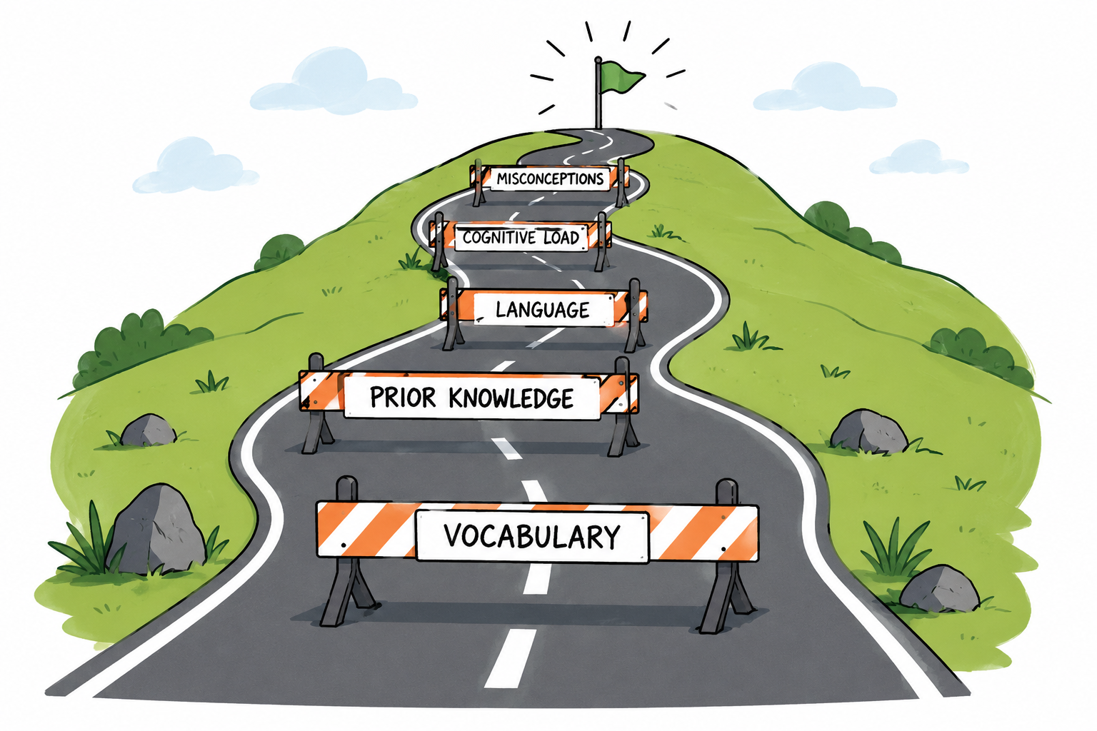
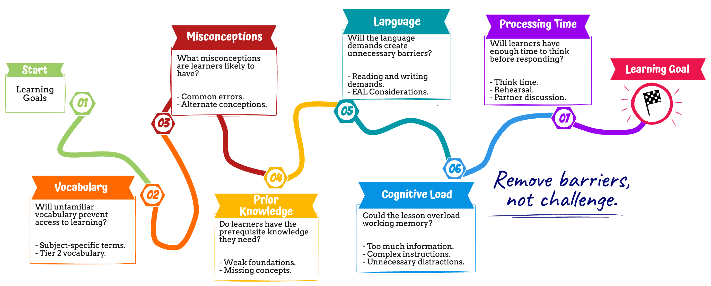
ADAPTS
D — Design
What barriers might prevent success?
Notes:
Made on sketchwow

Slide 9

ADAPTS
A — Act
How will I teach this lesson?
Deliver high-quality instruction by enacting your planned supports.
Modelling
Guided Practice
Retrieval Practice
High-quality teaching is the foundation of adaptive teaching.
Checks for Under-standing
Vocabulary
Scaffolds
Clear Explanations
Worked Example(s)

Slide 10

ADAPTS
P — Probe
What is the evidence of learner understanding right now?
Discussion
What are learners saying to one another?
Misconceptions
What misconceptions are emerging?
Student explanations
Can learners explain their thinking?
Written work
What does the work show?
Confidence
Who is confident? Who needs support?
Fluency
Is the learning becoming fluent?
Participation
Who is participating? Who is opting out?
Mini whiteboards • Questioning • Cold Call • Exit Tickets • Think Pair Share • Hinge Questions
These are tools. The goal is evidence.

Slide 11
ADAPTS
T — Tailor
Given the evidence, what should I adjust next?
What do learners need most right now?
Explanation
Do learners need a different explanation?
Questioning
Should I probe more deeply or widen participation?
Misconceptions detected.
Re-explain, model, change example.
…
Low confidence /uncertainty.
Guided practice, more support, check in.
Pace
Should I slow down or move on?
Grouping
Should I change how learners are working?
Some secure, some not.
Flexible grouping, targeted or peer support.
Most learners secure.
Increase challenge, deepen or extend thinking.
Scaffolds
Do learners need more support or less support?
Practice
Do learners need more practice or more challenge?
Everyone secure.
Remove scaffolds and increase independence.

Slide 12
ADAPTS
Given the evidence, what should I adjust next?
T — Tailor
More
Just right
Less
Explanation
Re-explain, model, change example?
Scaffolds
Add support, remove support?
Pace
Slow down or move on?
Questioning
Probe deeper? Broaden participation?
Grouping
Change how learners are working?
Practice
More practice? More challenge?

Slide 13
ADAPTS
S — Step Back
Fade Support
When is it time to step back support?
Step-by-step
How do I know?
High Support
Learners can...
Complete the task without prompts.
Model
The goal isn't better scaffolds. It's learners who no longer need them.
Explain their thinking independently.
Worked Example
Scaffold
Correct errors without immediate help.
Prompts
Hint
Apply learning to a new situation.
Check-in
Fade one support at a time
Step back the support and probe again.
If learners struggle (beyond productive), reintroduce the support temporarily.
Independent Learning

Slide 14
Adaptive Teaching Isn't...
Myth | It is…
Different learning goals | A common learning goal
Easier work for some learners | Appropriate support so everyone can reach the goal
Permanent scaffolds | Temporary scaffolds that are gradually removed
Different lesson plans | Responsive teaching within one lesson
Teaching to labels | Teaching to evidence
Lower expectations | High expectations with flexible support

Slide 15
Choosing the Right Adaptive Strategy
1
2
3
4
5
Identify the Barrier
Check the Evidence
Adjust Support
Check Again
Fade the Support
Can learners now succeed more independently?
What is preventing success?
What is the learner showing me?
What support will help right now?
Did it improve learning?
-- Examples --
Learners are struggling with key words.
Possible response:
Clarify key language or add a visual.
Mis-conception
Learners are showing incorrect understanding.
Possible response:
Re-explain, model or use a better example.
Cognitive Load
Too much information is overwhelming learners.
Possible response:
Chunk the task or remove unneeded complexity.
Vocabulary
Adaptive teaching isn't about using more strategies. It's about choosing the right one for the evidence.

Slide 16
-- Before the Lesson --
The ADAPTS Cycle
AIM
Clarify the learning goal for all.
DESIGN
Anticipate barriers and plan high-quality support.
Adaptive teaching is a continuous cycle, not six separate steps.
ACT
PROBE
TAILOR
STEP BACK
Teach with clarity and intentionality.
Gather evidence of learning.
Adjust teaching and support in response to evidence.
Remove support when learners are ready.
-- During the Lesson --
This cycle happens repeatedly throughout the lesson.
Next learning goal...
Adaptive teaching is responsive teaching that maintains a common learning goal whilst varying the support.

Slide 17
Reflection: Pick a Lesson This Week…
Where do learners typically struggle in this lesson?
How will I know they are struggling?
What is my first response likely to be?
What evidence will tell me it worked?
When can I remove support?

Slide 18
ADAPTS Reflective Cycle
A
Aim
What matters most?
What is the ambitious learning goal for every learner?
S
Step Back
D
Design
When can I reduce support?
How will I know learners are ready for greater independence?
What barriers should
I anticipate?
What might prevent success and what support will help?
T
Tailor
A
Act
How will I respond?
Given the evidence, what should adjust next?
What will excellent teaching look like?
How will I teach this lesson and deliver high-quality instruction?
P
Prompt
Adaptive teaching begins with planning, but it improves through reflection.
What evidence will
I collect?
What is the evidence of learner understanding right now?

Slide 19
Useful Links:
Morgan Whitfield (Online Course & Book)
Jade Pearce: Demystifying Adaptive Teaching
Caroline Bentley-Davies: A Little Guide…
The EEF: Move to Adaptive Teaching Guide
Chartered College: Adaptive Teaching
@Gina Davies

Slide 20
BARRIER
What's getting in the way?
EVIDENCE
What does the evidence show?
CHOOSE STRATEGY
What will help right now?
FADE SUPPORT
When secure, step back.
PROBE AGAIN
Did it work?
Struggle to explain terms
﻿﻿Incorrect or limited use of vocabulary
Pre-teach vocabulary
Use visuals, word walls, sentence stems, glossaries.
Ask learners to use the vocabulary in their own explanation or example.
Reduce visual supports and sentence stems.
Expect independent use.
Vocabulary
Inaccurate responses
"I don't remember this"
Retrieval practice
Recap, connect, build on what they know.
Quick retrieval check or low-stakes questioning to re-assess.
Space retrieval out.
Expect recall without teacher prompts.
Prior Knowledge
Choosing the Right Adaptive Strategy
Mis-conceptions
Incorrect reasoning
﻿﻿Conflicting explanations
Address misconceptions
Re-explain, model, use a new example.
Ask learners to explain their thinking again.
Use hinge questions.
Remove support
and check for correct application.
Cognitive Load
Overwhelmed responses
Incomplete work
Reduce cognitive load
Chunk content, simplify language, remove unnecessary detail.
Check understanding of each chunk before moving on.
Introduce complexity gradually. Encourage independent processing
Build confidence
Guided practice, partner talk, success criteria made explicit.
Observe participation.
Use cold call / random selection.
Increase independence.
Use targeted praise and challenge.
Hesitant responses
﻿﻿Low participation
Confidence
Need more challenge
Increase challenge
Deeper questions, transfer tasks, open-ended problems, extension.
Look for depth of thinking and ability to transfer learning
Remove all scaffolds.
Expect independent application and greater depth.
Quick completion
﻿﻿High accuracy
Notes:
Print as a poster

