Slide 1
Pocket PL:
Menstrual Cycle

Slide 2

Our Objectives:
Describe the four main phases of the menstrual cycle
Explain some of the hormonal and physical changes that happen across the cycle
Identify common symptoms, ways to manage them, and when to seek support

Slide 3
What Is The Menstrual Cycle?
The menstrual cycle is the body’s repeating monthly process of preparing for a possible pregnancy.
It is controlled by changes in hormones that help coordinate what happens in the brain, the ovaries, and the uterus.
The cycle is not just a period. Menstruation is only one part of a wider hormonal pattern that affects the whole body.

Slide 4
The Cycle
Across the cycle, an egg matures in the ovary, the lining of the uterus thickens, and if pregnancy does not occur, that lining is shed as a period.
Although people often talk about it as a 28 day cycle, cycle length can vary, and variation from person to person is normal.

Slide 5
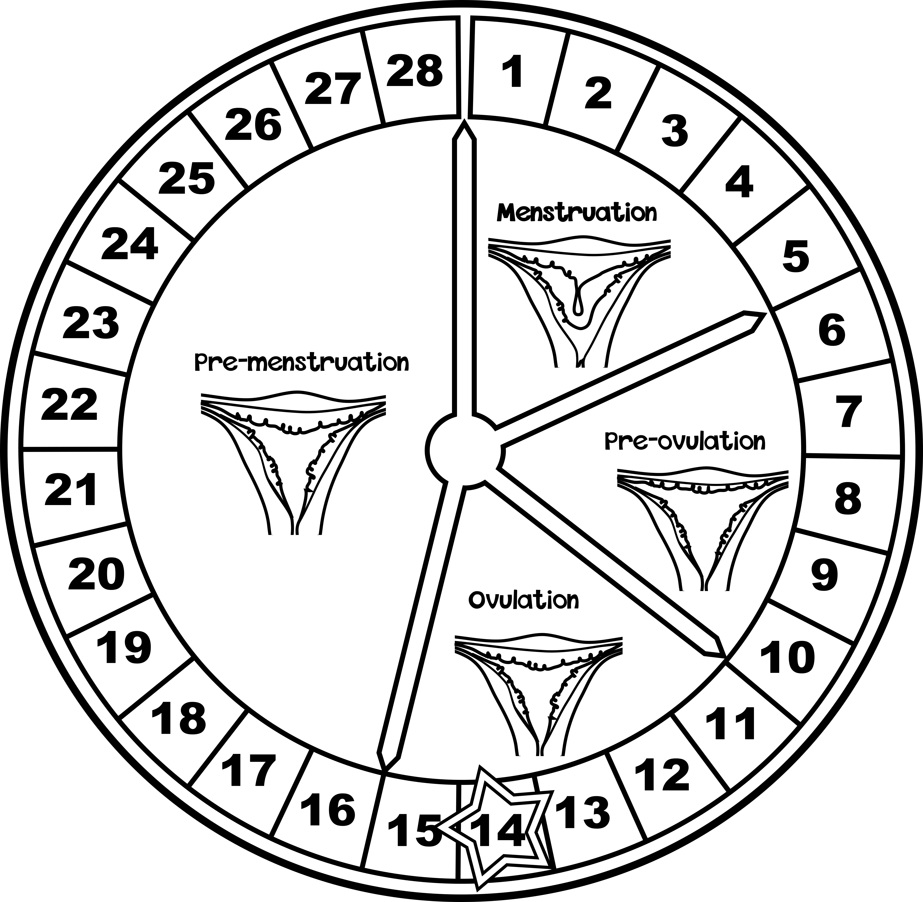
Four Main Phases:
1
28
Follicular Phase
Luteal Phase
The ovary is maturing an egg, and the uterus is rebuilding its lining.
The body prepares for possible pregnancy
1-5
~14
Menstrual Phase
Ovulation
Ovulation is the release of a mature egg from the ovary.
This is the phase when bleeding occurs.

Slide 6

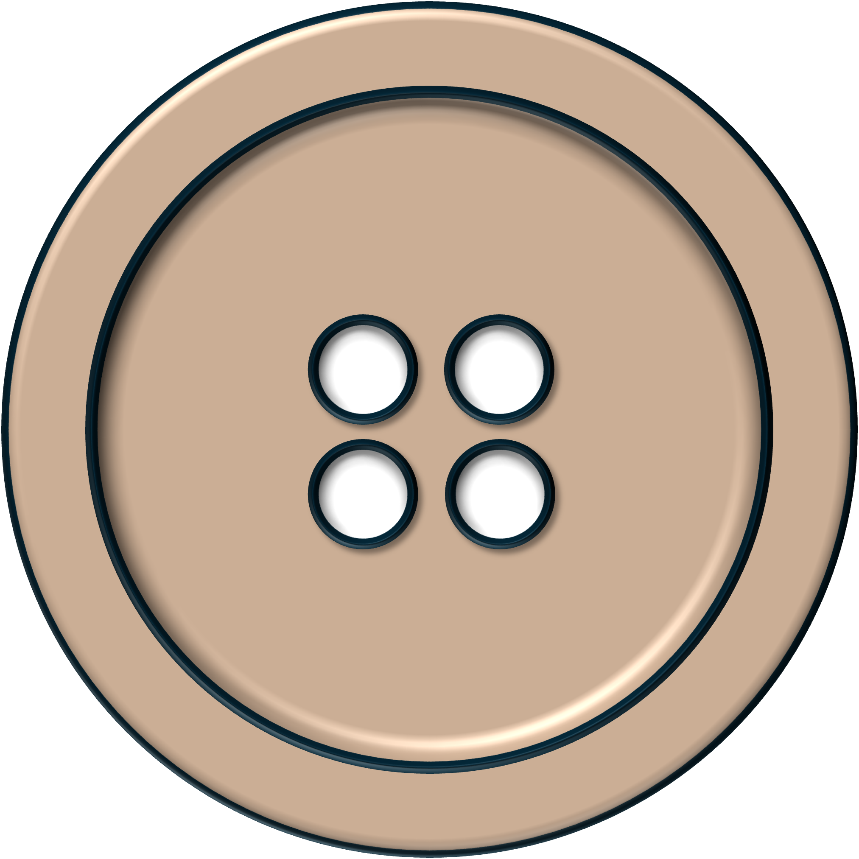
Just Before Menstruation
Why?
In the days before menstruation, hormone levels begin to fall. These changes can affect different parts of the body and lead to a range of symptoms.
Common Symptoms:
  Headaches
  Acne
  Bloating
  Breast Tenderness
  Mood Changes
  Food Cravings

Slide 7
Just Before Menstruation
Oestradiol and Progesterone
Before menstruation begins, oestradiol and progesterone levels fall.
Oestradiol
Progesterone
0
7
14
21
28
Time / Days
These hormone changes can affect the brain, skin, digestion, appetite, and mood, which is why some people notice symptoms before their period starts.

Slide 8
Bloating
What it is:
Bloating is a feeling of fullness, tightness, or swelling in the abdomen.
Why:
It can happen because hormone changes before and during a period can cause the body to hold more water and affect digestion.

Slide 9
Acne
What it is:
Some people notice spots or breakouts in the days before their period.
Why:
Hormone changes across the cycle can affect the skin and increase oil production, which can lead to breakouts.

Slide 10
Headaches
What they are:
Some people get headaches or migraines just before or during menstruation.
Why:
They can be triggered by the drop in oestradiol just before a period starts.

Slide 11
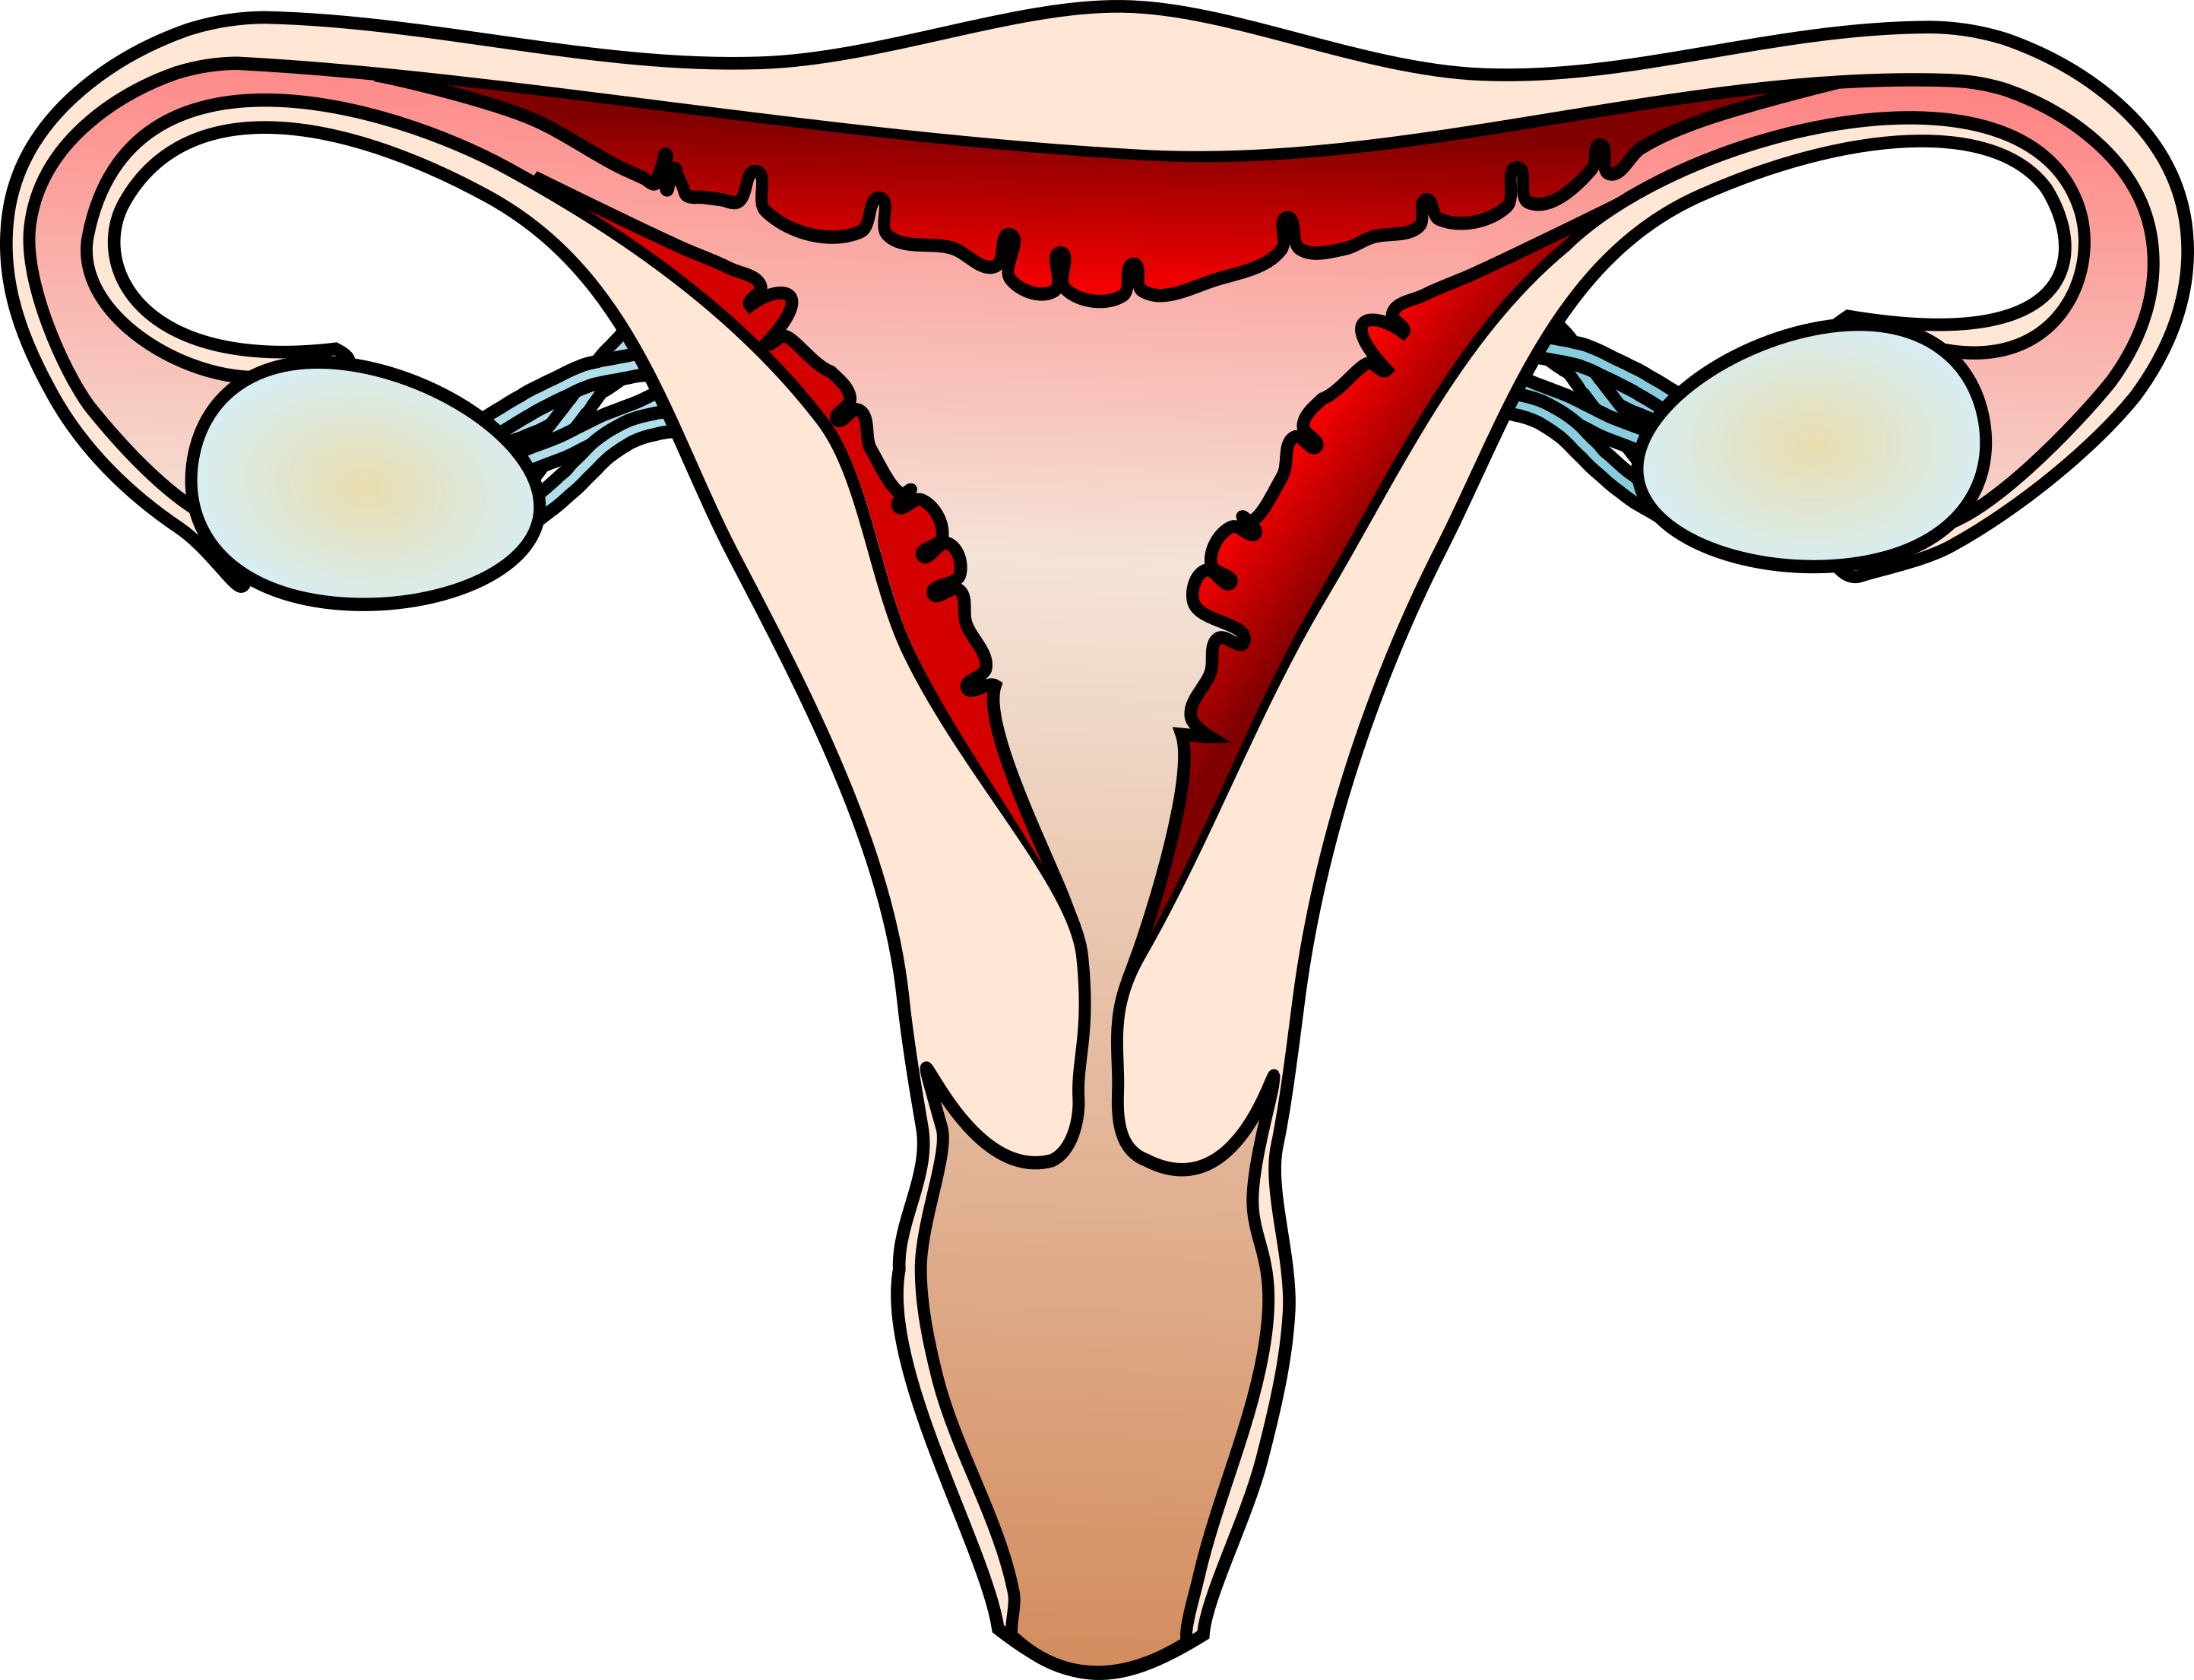
During Menstruation
Duration: Typically 3-7 days
Common Symptoms:
  Bleeding
  Cramps
  Blood Clots
  Bowel Changes
  Lower Back Pain
  Tiredness
Notes:
Bloating here too

Slide 12
During Menstruation
Why?
During menstruation, the lining of the uterus breaks down and leaves the body as menstrual blood.
As the uterus sheds its lining, it contracts to push blood and tissue out of the body.
This is why some people experience cramps, blood clots, bowel changes, and lower back pain during their period.

Slide 13
Cramps
What they are:
Cramps are pain or discomfort in the lower abdomen during a period.
Why:
The uterus contracts to help shed its lining. These contractions are triggered by chemicals called prostaglandins.
Notes:
Mild to moderate cramps are common. Stronger cramps can happen when prostaglandin levels are higher.

Slide 14
Blood Clots
What they are:
Blood clots are small, jelly like pieces of blood that can come out during a period.
Why:
When bleeding is heavier, blood can collect faster than the body can break it down, so small clots may form.
Notes:
Small clots can be normal, especially on heavier days. Very large clots or very heavy bleeding may need medical advice.

Slide 15
Bowel Changes
What they are:
Bowel changes can include diarrhoea, needing to poo more often, cramping, or sharp pains during a period.
Why:
The same chemicals that make the uterus contract can affect the bowels too.

Slide 16
Lower Back Pain
What it is:
Some people get aching or pain in the lower back during their period.
Why:
It can happen because the uterus is contracting, and the same chemicals involved in cramps can also cause pain that spreads to the lower back.

Slide 17
Ovulation
What it is:
The release of a mature egg from the ovary.
When:
It usually happens around the middle of the cycle, although cycle length can vary.
Symptoms:
Some people notice mild pain, clear, stretchy discharge, or small changes in energy or mood.

Slide 18
Hormones at a Glance:
FSH
Helps an egg begin to mature in the ovary.
LH
Triggers ovulation, the release of an egg.
Oestradiol
Helps rebuild the lining of the uterus.
Progesterone
Helps maintain the lining of the uterus.
These hormones rise and fall at different points in the cycle, helping to control what happens in the ovaries and uterus.

Slide 19
Understanding Your Pattern
Why?
The menstrual cycle can affect people differently. Tracking symptoms can help you notice patterns in pain, headaches, bloating, mood, energy, and bleeding.
Things to Track:
  Period Start
  Pain or Symptoms
  Flow (how heavy it is)
  Mood and Energy Changes

Slide 20

What Helps?
Heat
  A hot water bottle, heat pack, or warm bath can help ease cramps.
Movement
  Many people find that gentle movement or exercise helps with symptoms.
Food and Hydration
  Eating regularly and drinking enough water may help with energy and headaches.

Slide 21
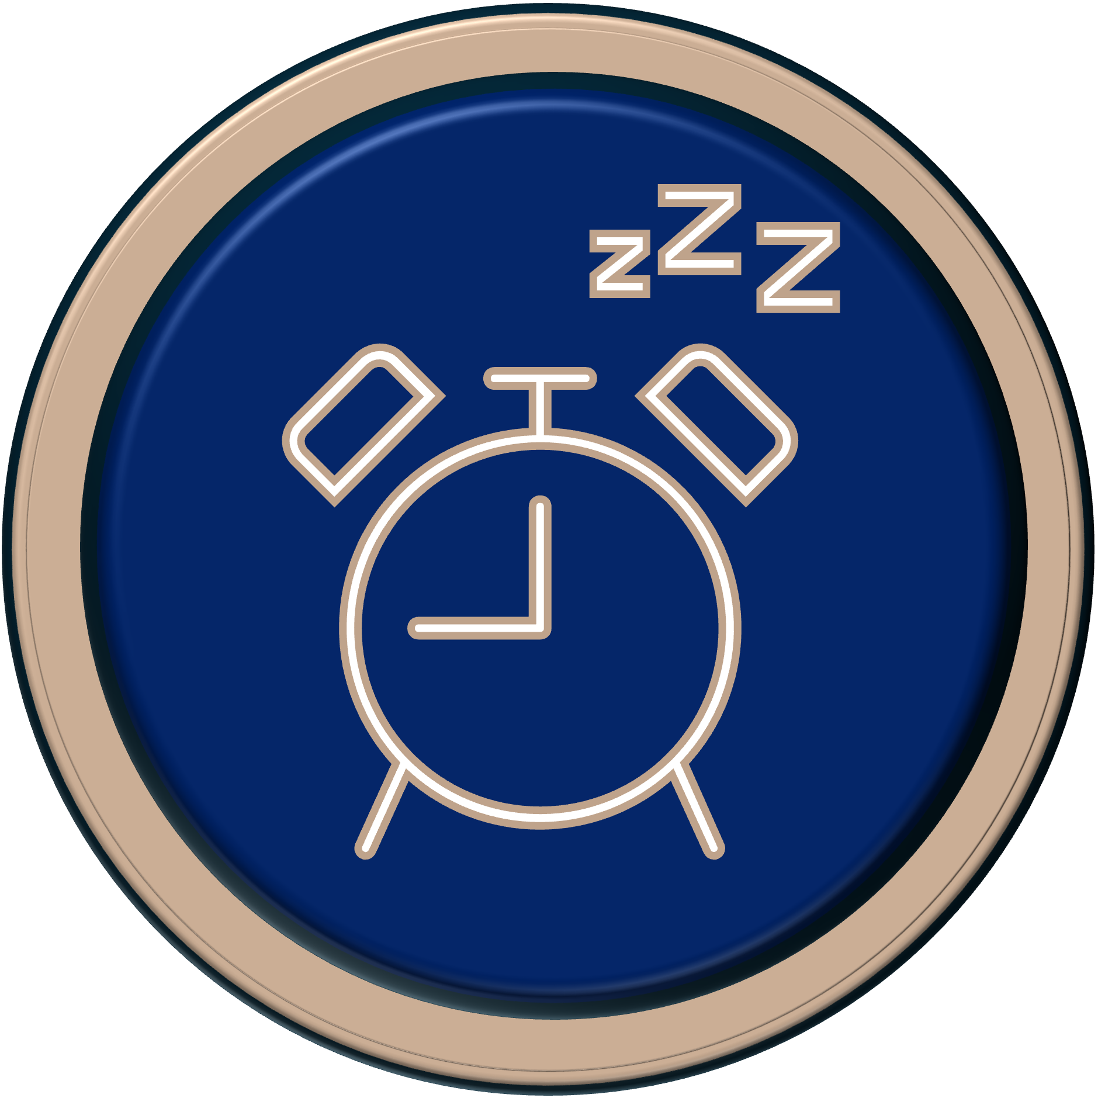
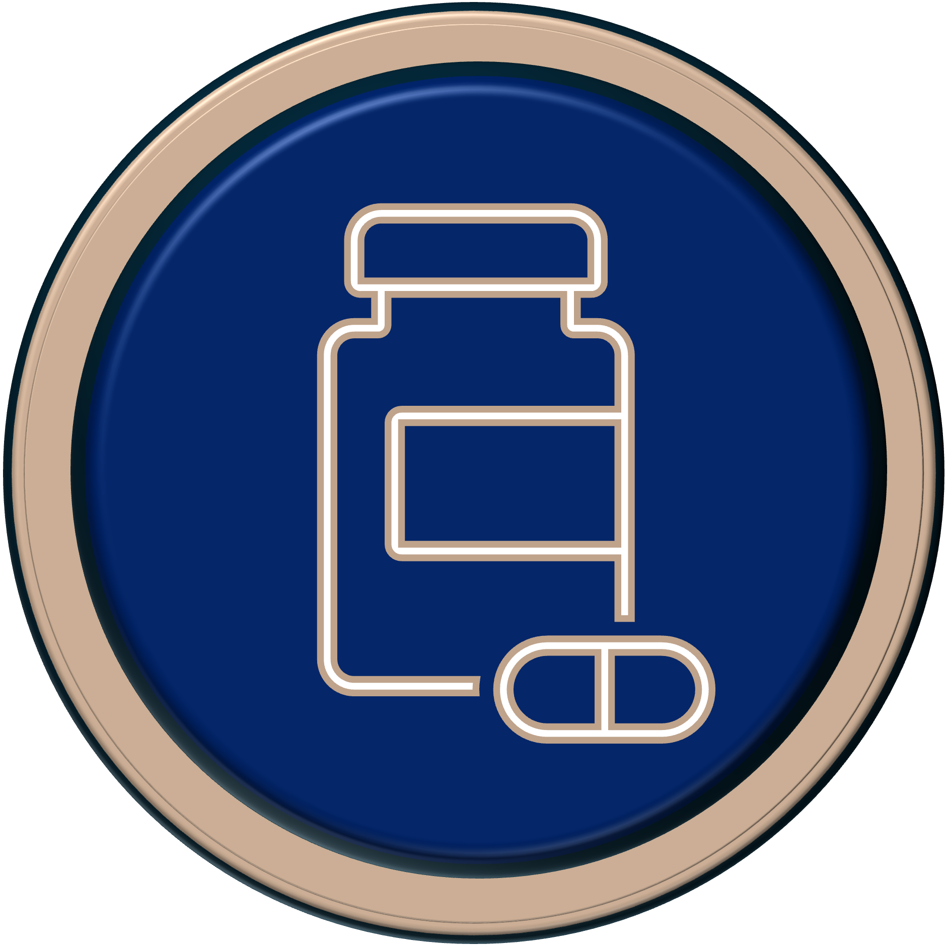
What Helps?
Rest and Sleep
  Extra rest may help when periods are painful or tiring.
Pain Relief
  Some people use pain relief, such as paracetamol or ibuprofen, to help with cramps.
  Be Prepared
  Having period products, pain relief if appropriate, and a plan for school or activities can help people feel more in control.
Notes:
Pain relief should be used safely and according to advice on the packet, or guidance from a parent, carer, pharmacist, or doctor.

Slide 22
Menstrual Products
Different products suit different people. Choice can depend on comfort, flow, confidence, age, and personal preference.
Examples:
  Pads
  Tampons
  Period Underwear
  Menstrual Cups

Slide 23
Menstrual Products
  Pads:
  Worn in underwear to absorb menstrual blood.
  Tampons:
  Inserted into the vagina to absorb menstrual blood.
  Period Underwear:
  Absorbent underwear designed to be worn during a period.
  Menstrual Cups:
  Reusable cups inserted into the vagina to collect menstrual blood.

Slide 24
When to Ask For Help:
It’s okay to ask for help if symptoms are severe or start affecting daily life.
Examples:
  Severe pain
  Heavy bleeding
  Repeated bowel symptoms
  Changes affecting daily life
  Changes that don’t feel right

