Slide 1
Pocket PD:
Why Sleep Matters: Science & Habits for Well-being

Slide 2

Why This Matters:
Teenagers need 8–10 hours of sleep, but most get 6–7.
Poor sleep = lower grades, weaker memory, and reduced focus.
It also affects mood, motivation, and relationships.
For staff and students: sleep is key for clear thinking, resilience, and emotional regulation.
“The shorter your sleep, the shorter your life.” – Dr Matthew Walker

Slide 3

What Happens During Sleep
Sleep is an active process where the brain and body repair, reset, and grow.
We cycle through stages of non-REM and REM sleep every 90 minutes.
Deep sleep: physical restoration, immune support, memory consolidation.
REM sleep: emotional processing, creativity, and dreaming.

Slide 4
What Happens During Sleep
Each stage plays a unique role in learning, healing, and well-being.
Without sleep, the brain can’t file new memories or clear out waste; it’s like leaving your inbox full.

Slide 5
Why We Need Sleep:
Sleep boosts memory and learning.
It improves focus and decision-making.
Sleep stabilises mood and emotions.
It supports growth and physical repair.
Sleep strengthens the immune system.
It balances hunger and stress hormones.
Sleep keeps the body clock in rhythm.
It clears brain toxins and protects brain health.

Slide 6
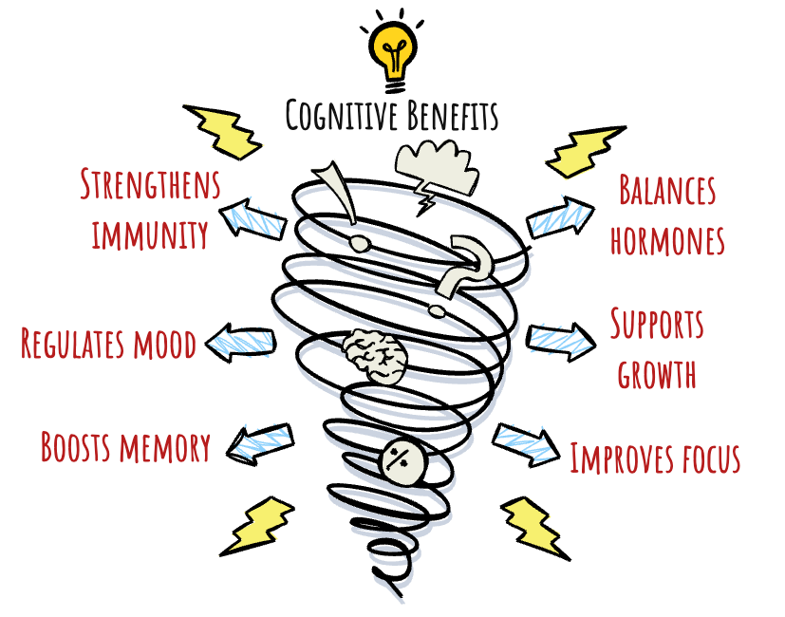
Why We Need Sleep:

Slide 7
Sleep and Learning
Sleep powers every part of the learning process.
Without sleep, the hippocampus can’t store new memories effectively, it’s like trying to save a file without clicking “Save”.
Encode
Consolidate
Retrieve
Learn
Prepares the brain to absorb new information
Strengthens and organises memories.
Enhances recall and problem-solving.
Sleep
Remember
Notes:
Yoo et al. (2007): Sleep-deprived students showed a 40% drop in memory formation.

Slide 8
Sleep and The Brain
During deep sleep, the glymphatic system flushes out toxins like beta-amyloid, which can build up and damage brain cells.
This cleaning process only happens effectively during deep, non-REM sleep.
Without it, waste builds up – increasing the risk of cognitive decline, brain fog, and long-term conditions like Alzheimer’s.
Sleep is like a nightly power wash for your brain!

Slide 9
Teen Sleep and Circadian Rhythms
During adolescence, melatonin is released later in the evening, shifting the natural sleep–wake cycle by 1–3 hours.
This is called a circadian phase delay – it’s biological, not laziness.
Early school starts often clash with this natural rhythm, leading to chronic sleep deprivation in teens.

Slide 10
Hormones and Sleep
Hormone | What It Does | Sleep Impact
Melatonin | Regulates sleep–wake cycle | Released later in teens; suppressed by screen light
Cortisol | Stress response and alertness | Poor sleep = higher cortisol = more anxiety/stress
Growth Hormone | Supports growth and repair | Released in deep sleep – crucial during adolescence
Ghrelin & Leptin | Control hunger and fullness | Less sleep = more hunger, less satiety
Tired brains crave sugar and carbs, not salad.

Slide 11
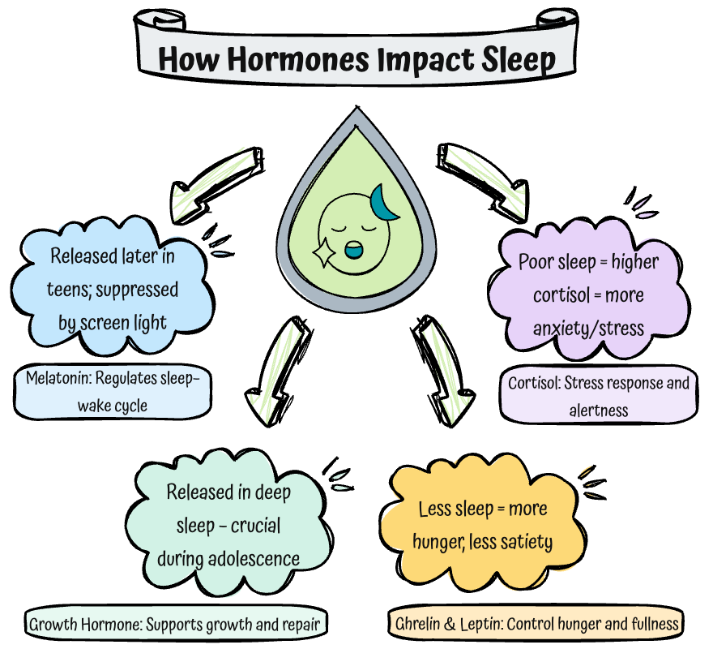

Slide 12
Sleep Deprivation
Poor concentration and memory
Mood swings, anxiety, and irritability
Slower thinking and poor decision-making
Weakened immune system
Higher risk-taking and reduced impulse control
Increased cravings and unhealthy eating
Burnout and reduced emotional resilience (especially in teachers!)
One night of poor sleep can impair brain function as much as being over the alcohol limit.

Slide 13
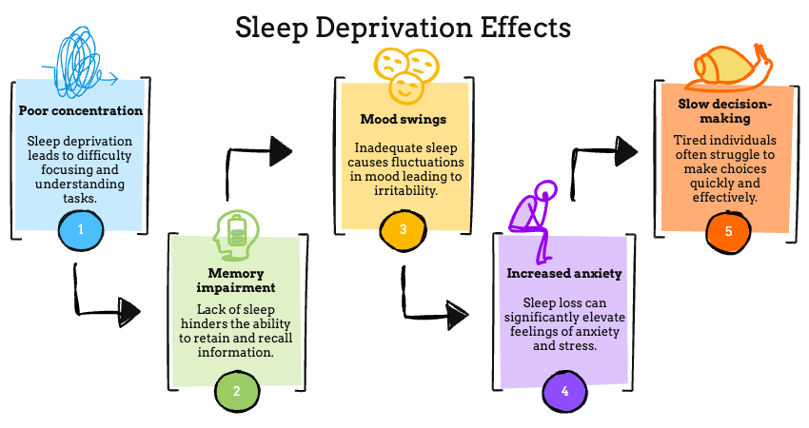
One night of poor sleep can impair brain function as much as being over the alcohol limit.
Notes:
Similar, but prettier.

Slide 14
Sleep Hygiene Tips
Tip | Why It Works
Keep a regular sleep schedule | Regulates your body clock
Avoid screens 1 hour before bed | Blue light delays melatonin release
Keep your room cool and dark | Ideal sleep temp is ~18°C; darkness promotes sleep
No caffeine after 2pm | Caffeine stays in your system for 5–7 hours
Wind down before bed | Reading or journaling signals your brain it’s time to sleep
Use your bed for sleep only | Helps your brain link bed with rest, not work
Better sleep starts with better habits. Every day, not just the night before a test!

Slide 15
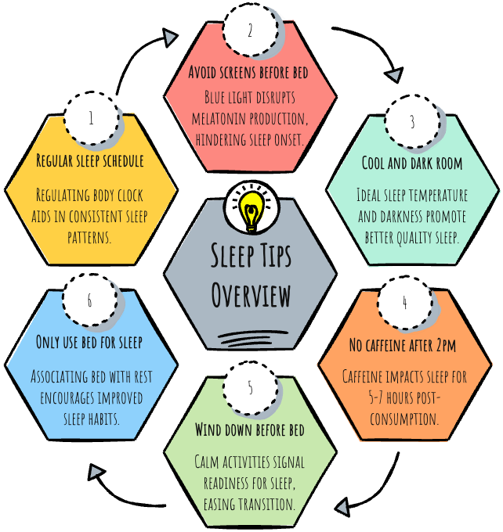
Sleep Hygiene Tips
Better sleep starts with better habits. Every day, not just the night before a test!
Notes:
Similar, but prettier.
Discuss one by one.

Slide 16
You can catch up on sleep at the weekend
Sleep: Fact or Fiction?
Fiction!
You may feel more rested after a lie-in, but you cannot fully undo the damage of sleep loss during the week. It also confuses your body clock, making it harder to sleep well the next night.

Slide 17
Teenagers are just lazy in the mornings
Sleep: Fact or Fiction?
Myth!
Teen brains release melatonin later at night, which naturally shifts their sleep–wake cycle. It’s biological, not laziness. Early school starts clash with their natural rhythm.

Slide 18
Screens affect your brain’s ability to sleep
Sleep: Fact or Fiction?
Fact!
The blue light from phones, tablets and laptops delays melatonin release and makes it harder for your brain to wind down. Even one hour of screen-free time can help you fall asleep faster.

Slide 19
You only need 6 hours of sleep to be healthy
Sleep: Fact or Fiction?
Myth!
Most teenagers need 8–10 hours of sleep for brain development, memory, focus and emotional regulation. Getting less than that affects academic performance and mood.

Slide 20
Sleep helps you remember what you learned
Sleep: Fact or Fiction?
Fact!
During sleep, your brain replays and strengthens new learning, like pressing save on a document. Without enough sleep, your brain struggles to store and recall information.

Slide 21

7-Night Sleep Challenge
Pick one thing to try for a week:
Keep the same bedtime all week
No screens 30 mins before bed
Try journaling before sleep
No caffeine after 2pm
Set an alarm for winding down

Slide 22
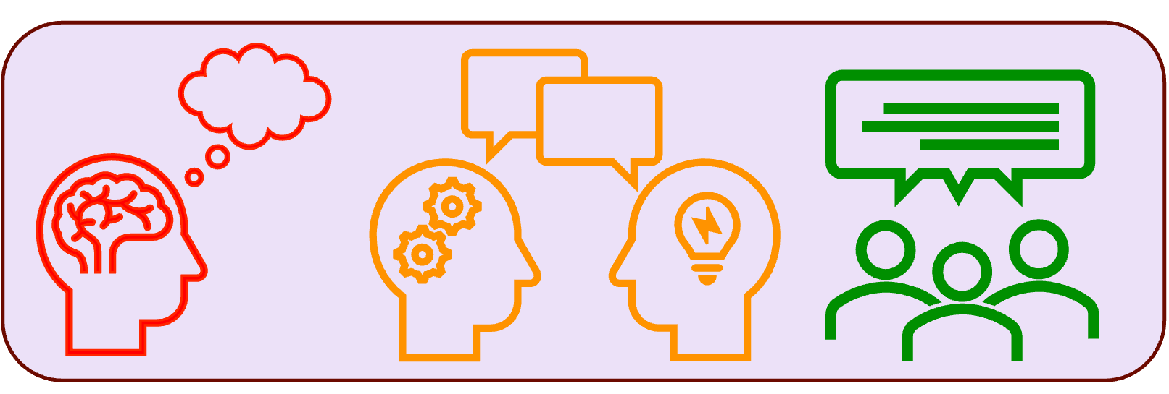
What’s your sleep personality?
What time do you usually go to bed on school nights?
What helps you fall asleep? What keeps you awake?
What do you do when you can’t sleep?
What’s one thing you would like to change about your sleep habits?
Notes:
Think, Pair, Share

Slide 23
Build Your Routine: Task
Reflect on your current routine.
Learn the science.
  Briefly review the key factors for good sleep hygiene: regular schedule, screen-free time, calming activities, cool/dark environment, no caffeine late in the day.
Design a personalised wind-down routine (30–60 minutes).
Include at least 3 activities that will prepare your body and brain for sleep.
Plan your ideal bedtime and wake-up time.
Write your routine as a timeline.
Notes:
Reflect on your current routine.
What time do you usually go to bed and wake up?
How do you wind down (if at all)?
What habits might be disrupting your sleep?
Use the following categories for inspiration:
🌙 Relaxation: shower, breathing, reading, music
📵 Tech boundaries: phone-free zone, blue light blockers
🕯 Environmental setup: dim lights, comfy bedding
📝 Mind clearance: journaling, gratitude lists

Slide 24
Pick One – Exit Pass
What’s one myth you believed that was challenged today?
Which habit do you want to try changing first?
What might help you stick with it?

Slide 25
Useful Links:
Harvard: Sleep and Memory
Sleep: News in Health
Yale: Sleep and Memory
@Gina Davies

