Slide 1
Pocket PD:
Menopause: Taking Care of Ourselves and Others

Slide 2
Disclaimer:
I am not medically trained.
My insights are drawn from my background in science (BSc, MSc), my personal experience with perimenopause, the research I have conducted, and conversations with colleagues and friends.
This session is intended to provide basic awareness and is not a source of in-depth or medical advice.
!

Slide 3
Our Objectives:
Increase understanding of perimenopause and menopause.
Explore self-care strategies for educators.
Identify ways to support colleagues and create a menopause-friendly environment.

Slide 4
What Is Menopause?
Perimenopause and menopause are natural biological processes that mark significant hormonal transitions in a person’s life.
Whilst it is a natural process, it can be induced:
Surgically: Ovary removal causes a sudden hormone drop, leading to symptoms.
Medically: Treatments like chemotherapy can halt ovarian function, triggering symptoms.

Slide 5
Stages:
~35 - 45
~45 - 55
~55+
~51
~51
Perimenopause
Menopause
Postmenopause
The transitional phase before menopause.
When no menstrual cycle has occurred for 12 consecutive months.
The phase after menopause.
Menopause is often used as an encompassing term.

Slide 6
Perimenopause (Late 30’s to Mid-40s)
Duration: Typically 4–10 years.
Key Changes
Hormonal fluctuations begin; periods become less regular.
Common Symptoms:
Hot flushes and night sweats.
Mood changes and anxiety.
Fatigue and sleep disturbances.
Weight gain and metabolism changes.

Slide 7
Menopause (Mid-40s to Mid-50s)
Definition: The natural end of reproductive years, defined as 12 consecutive months without a period.
Key Changes:
Oestrogen levels drop significantly.

Slide 8
Menopause (Mid-40s to Mid-50s)
Common Symptoms:
Continued hot flushes and night sweats.
Cognitive changes and brain fog.
Increased risk of bone density loss.
Changes in skin and hair texture.

Slide 9
Postmenopause (Mid-50s and Beyond)
Key Changes: Hormonal levels stabilise at lower levels.
Common Symptoms:
Symptoms may persist but often lessen in severity.
Increased risk of osteoporosis, heart disease, and urinary tract issues.

Slide 10
Hormones
During perimenopause and menopause, significant hormonal fluctuations occur, primarily involving oestrogen and progesterone.
These hormonal changes lead to a range of physical, emotional, and cognitive symptoms that vary widely amongst individuals.
Notes:
Pituitary hormones increase and ovarian hormones decrease

Slide 11
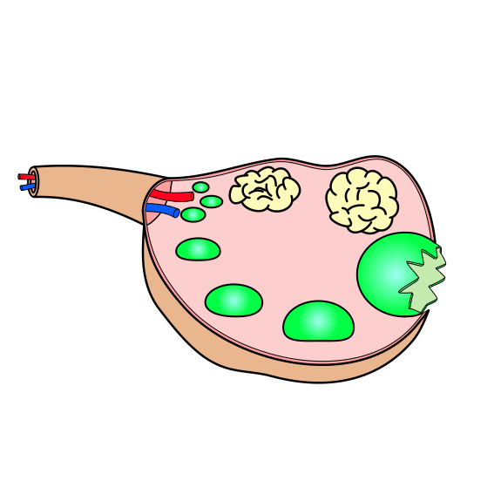
Ovary
Why: Some Science
Corpus Luteum
We are born with a finite number of eggs (oocytes). As we age the number and quality of our eggs decreases.
Each month we mature an egg and release it, the empty follicle that the egg is released from becomes a corpus luteum.
Maturing follicle containing an egg
Notes:
This is simplistic. I drew that!

Slide 12
Why: Some Science
Ovary
Oestrogen and progesterone are both produced and released primarily from the ovaries.
Oestrogen is mainly produced by the maturing follicles.
Your ovaries start to fail as you age. They become less responsive to FSH, less efficient at producing oestrogen, and you also have fewer follicles to produce oestrogen.
So, we produce less oestrogen.
Notes:
There are negative and positive feedback systems in place

Slide 13
Ovary
Why: Some Science
Progesterone is produced by the corpus luteum.
As we age, ovulation becomes less regular, and during some cycles, an egg is not released; this is known as anovulation.
Without ovulation, the corpus luteum does not form, and therefore, progesterone is not produced.
With age, the corpus luteum becomes less efficient at producing progesterone.
Notes:
There are negative and positive feedback systems in place

Slide 14
Why: Some Science
FSH and LH are released from the pituitary gland and act on the ovaries.
FSH stimulates the follicles in the ovaries to produce oestrogen.
LH stimulates the corpus luteum to produce progesterone.
When the ovaries aren’t responding to them, more is released to try to compensate and cause a response.
Notes:
Act on – they tell the ovaries to release hormones

Slide 15
Oestrogen
What is it?
A steroid hormone which exists in three forms:
Oestradiol: Dominant during reproductive years.
Oestrone: Main form after menopause.
Oestriol: Lots during pregnancy.
What does it do?
Regulates the menstrual cycle and supports heart, bone, and brain health.
Maintains skin elasticity and hydration.

Slide 16
Oestrogen
Effects of Declining Oestrogen:
Hot flushes and night sweats.
Vaginal dryness and discomfort.
Mood swings and increased anxiety.
Cognitive changes: memory issues and brain fog.
Increased risk of osteoporosis and cardiovascular disease.
Notes:
Oestrogen is also stored and produced in fat cells, particularly after menopause when ovarian production of it significantly declines. Adipose tissue contains aromatase, which converts androgens (such as testosterone) into oestrogen, primarily in the form of oestrone. This process helps maintain some level of oestrogen in the body even after ovarian production of it stops.
This is a reason we need to have more body fat than men.

Slide 17
Progesterone
What is it?
A steroid hormone. It is also produced in smaller amounts by the adrenal glands.
What does it do?
Regulates the menstrual cycle and supports sleep.
Prepares the uterus for pregnancy and supports early fetal development.
Balances the effects of oestrogen.
Notes:
During pregnancy some is produced by the placenta

Slide 18
Progesterone
Effects of Declining Progesterone:
Irregular and heavier menstrual cycles
Sleep disturbances and insomnia
Increased anxiety and irritability
Heightened sensitivity to stress

Slide 19
Testosterone
What does it do?
Supports muscle mass, libido, and energy levels.
Effects of Declining Testosterone:
Reduced energy and motivation.
Decreased libido.
Loss of muscle strength.

Slide 20
Luteinising Hormone
Increased LH production is due to lower oestrogen.
Effects of Increasing LH
Hot Flushes & Night Sweats
Mood Changes
Sleep Disturbances
Ovarian Function Cessation
Bone Loss Risk
Notes:
LH is responsible for stimulating ovulation
It can also cause testosterone imbalance which may lead to facial hair growth

Slide 21
Follicle Stimulating Hormone
Increase FSH production is due to lower oestrogen and progesterone.
Effects of Increasing FSH:
Irregular or Absent Periods
Vaginal Dryness and Atrophy
Reduced Fertility
Ovarian Function Decline
Notes:
FSH is responsible for stimulating follicles in the ovary to mature an egg. It increases to try and make that happen – not realising that the ovaries aren’t able to respond like that used to.

Slide 22
Melatonin
Naturally decreases with age, but hormone changes further affect its production.
Effects of Decreasing Melatonin:
Sleep Disturbances
Increased Fatigue
Mood Changes
Cognitive Decline
Hormone Imbalance
Increased Signs of Aging
Notes:
Increased signs of aging is due to increased oxidative stress, melatonin is an anti oxidant so lowering it…

Slide 23
Physical
Emotional
Cognitive
Well-being
Self-Care Strategies
Menopause brings significant changes. Adopting effective self-care strategies aimed at these can help manage symptoms and promote overall well-being.
Physical Well-being.
Emotional Well-being.
Cognitive Well-being.

Slide 24
Physical Well-being: Nutrition
Nutrition
Prioritise Protein – Supports muscle mass and metabolism (lean meats, fish, tofu).
Good Fats – Essential for heart and brain health (avocados, nuts, olive oil).
Increase Fibre – Aids digestion and hormonal balance (whole grains, vegetables).
Calcium & Vitamin D – Crucial for bone health (dairy, leafy greens, sunlight).
Limit: Caffeine, alcohol, sugar, and processed foods to manage symptoms and support overall well-being.
Exercise
Sleep
Notes:
Just one drink and I’m up at 2am

Slide 25
Physical Well-being: Exercise
Nutrition
Strength Training – Supports bone density and muscle mass (weights, jumping, squats, lunges, resistance bands). Think; strong, not skinny.
Exercise
Cardiovascular Exercise – Promotes heart health and aids weight management (walking, cycling, swimming, sprints). Wearing a weighted vest during walking can enhance benefits.
Yoga & Flexibility – Enhances mobility and reduces stress (yoga, Pilates, stretching).
Sleep

Slide 26
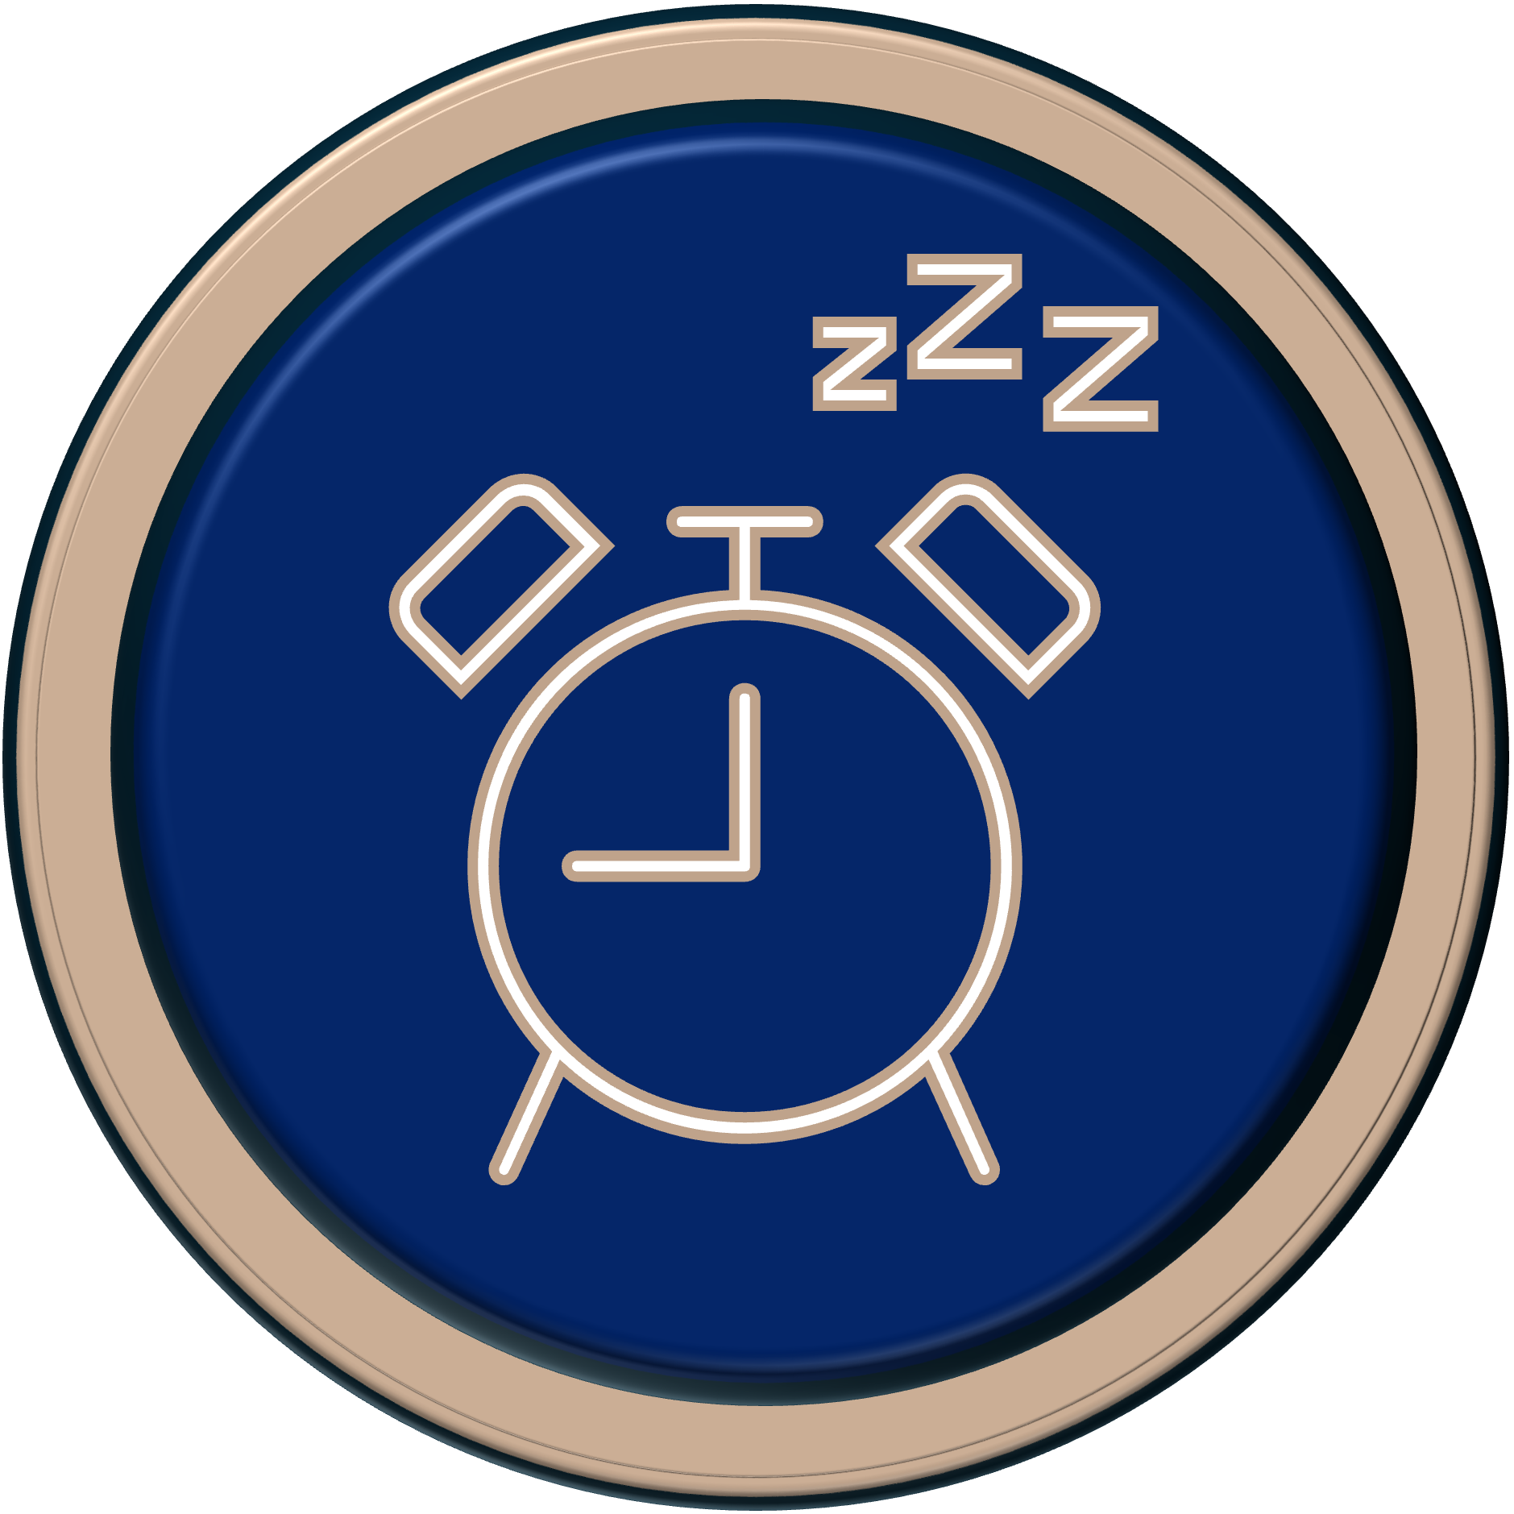
Physical Well-being: Sleep
Nutrition
Maintain a Consistent Schedule – Set regular sleep and wake times to support your body's internal clock. Yes, even at the weekend!
Exercise
Sleep
Relaxing Bedtime Routine – Wind down with calming activities like reading, meditation, or gentle stretching.
Notes:
A great book: The Circadian Code
If I exercise close to sleep time I cannot sleep – find what works for you.

Slide 27
Physical Well-being: Sleep
Nutrition
Optimise Sleep Environment – Keep your bedroom cool, dark, and quiet to promote restful sleep and manage night sweats.
Exercise
Limit Screen Time – Avoid screens an hour before bed to reduce blue light exposure and support melatonin production. Dim the lights at home from the early evening. Wear blue light glasses for evening work on a screen.
Sleep
Notes:
A great book: The Circadian Code
If I exercise close to sleep time I cannot sleep – find what works for you.
I wear blue light glasses after 5pm when I’m doing work.

Slide 28
Emotional Well-being
Stress
Mindfulness and Relaxation – Use techniques like meditation, deep breathing, and muscle relaxation to reduce stress and promote calm.
Work-Life Balance – Set boundaries to prevent burnout and engage in enjoyable activities and hobbies.
Journaling and Self-Reflection – Write thoughts to process emotions and practice gratitude to enhance positivity.
Spend Time in Nature – Step outside, connect with nature, and enjoy the benefits of the outdoors.
Support

Slide 29
Emotional Well-being
Stress
Seek Social Support
Connect with friends, family, or support groups to share experiences and reduce feelings of isolation.
If a local support group isn’t available, consider starting one, others may benefit from your initiative.
Consider talking to a therapist or counsellor for professional emotional support.
Support

Slide 30
Cognitive Well-being
Hormonal changes during menopause can cause brain fog, forgetfulness, and concentration difficulties, impacting self-identity.
Mental Stimulation
Challenge the brain: puzzles, reading, learning new skills.
Use brain-training apps to enhance memory and focus.
Organisation & Planning
Stay organised: planners, to-do lists, digital reminders.
Break tasks into smaller steps to improve focus.

Slide 31
Available Treatments
Prioritise Nutrition and Exercise – Establishing healthy habits is the first step to managing symptoms effectively.
Hormone Replacement Therapy (HRT) – The gold standard for menopause symptom relief.
Whilst HRT has some risks, much of the negative press is outdated. I’m not a doctor, also seek medical advice.
For those who cannot take HRT, SSRIs, gabapentin and clonidine can help manage hot flushes and night sweats.

Slide 32
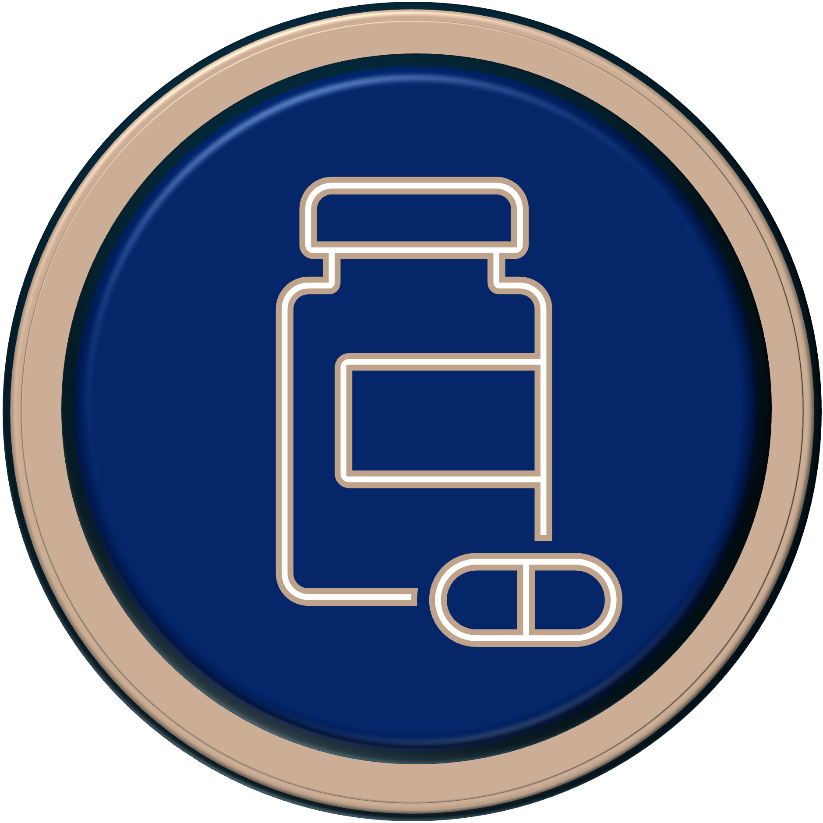
HRT
The type of HRT a person takes will be based on personal circumstance.
Benefits include:
Relieving hot flushes, mood swings, and vaginal dryness.
Protecting against osteoporosis by preserving bone density.
Supporting heart health by improving cholesterol and circulation.
Enhancing cognitive function and potentially reducing dementia risk.

Slide 33
Types of HRT
Oestrogen-Only HRT (for women without a uterus)
Available as patches, gels, tablets, and sprays.
Helps relieve symptoms such as hot flushes, vaginal dryness, and osteoporosis risk.
Combined HRT (oestrogen + progesterone)
Suitable for women with a uterus to protect against endometrial cancer.
Available in continuous or cyclical forms depending on needs.
Notes:
Testosterone - can improve libido, energy levels, and cognitive function.
There is also new body-identical HRT

Slide 34
During Perimenopause
Combined Oral Contraceptive Pill
Helps stabilise fluctuating hormone levels, reducing symptoms like irregular periods, heavy bleeding, and spotting.
Can alleviate common perimenopausal symptoms such as hot flushes, night sweats, and mood swings.
Can help with acne and hair thinning, which can be affected by hormonal changes.
Hormonal Coil
Helps control heavy, irregular, and painful periods
Can lead to lighter or no periods over time.

Slide 35
Medication
Vaginal Health Treatments
Vaginal oestrogen creams, tablets, or rings can alleviate dryness and discomfort.
Moisturisers and lubricants provide non-hormonal relief for vaginal symptoms.

Slide 36
Supplements
Calcium & Vitamin D
Support bone health and reduce the risk of osteoporosis.
Magnesium
Helps with sleep and muscle function.
B Vitamins
Support energy levels and cognitive function.
Creatine Monohydrate
For improving muscle strength, endurance, and recovery.
Omega-3 Fatty Acids
Help with heart and bone health and cognitive function.
Notes:
We should always try to get these through our food, but it is better to supplement if you can’t do that – I struggle with it.
Fibre can also be supplemented if needed.

Slide 37
Natural Remedies
Nutrition, Exercise, Sleep and Nature!
Black Cohosh – Hot flushes and night sweats.
Evening Primrose Oil – Hot flushes & breast tenderness.
Red Clover – Hot flushes.
Angelica – Hormonal balance.
Ginseng – Mood and energy.
St John's Wort – Mood and mild depression.
Natural remedies may offer relief for some women, but their effectiveness can vary, and scientific evidence is often limited. They may also interfere with other medications.
Notes:
Wild Yam Cream – hormone balance – evidence isn’t there.

Slide 38
Supporting Colleagues Through Menopause
Creating a supportive work culture
Listening without judgement, offering flexibility, encouraging conversations.
Practical steps for schools:
Policy development
Workplace adjustments
Peer support groups.

Slide 39
Discussion:
What menopause-friendly policies would you like to see in your workplace?

Slide 40
Here’s how you can make a difference:
Prioritise Your Well-Being – Focus on nutrition, exercise, and self-care.
Start the Conversation – Break the stigma by talking about menopause with colleagues and loved ones.
Advocate for Support – Encourage your workplace to adopt a menopause policy
Stay Informed – Use and share credible resources and seek professional advice for managing symptoms.
Small changes today can lead to a healthier, more supportive future.

Slide 41
Question:
What has worked for you that you think you should share with others?
Notes:
https://padlet.com/gdavies66/what-have-you-found-useful-in-navigating-menopause-perimenop-jp2pxxqkqwe373j

Slide 42
Workplace Adjustments and School Policies
You can sign up to receive a free copy of the WISE Menopause Policy.
This is a comprehensive policy with many great suggestions and recommendations.

Slide 43
Useful Links:
Dr Haver & Dr Berry – 5 Essentials
The ‘Pause Life
Haver on Hubermann
Self Care Effect
Knowledge is Power
WISE Menopause Policy
Gina Davies

Slide 44
Books:
The New Menopause - Dr. Mary Claire Haver
The Definitive Guide to the Perimenopause and Menopause - Dr. Louise Newson
The Female Body Bible - Dr. Emma Roxx, Baz Moffat, and Dr. Bella Smith
The Menopause Manifesto - Dr. Jen Gunter
Menopausing - Davina McCall
What Fresh Hell Is This? - Heather Corinna
Second Spring: The Self-Care Guide to Menopause - Kate Codrington

