Slide 1
Pocket PD:
Dual Coding

Slide 2
What is Dual Coding?
Dual coding is a learning theory that suggests combining words and visuals enhances learning and memory.
This approach leverages two processing channels in the brain to support better understanding and recall.
Allan Paivio, a Canadian psychologist, introduced the concept of dual coding in his book Imagery and Verbal Processes (1971).

Slide 3

Two Processing Channels:
The brain processes information through two distinct channels:
- Verbal (language-based)
- Visual (image-based)
Using both formats allows for a richer mental representation.

Slide 4
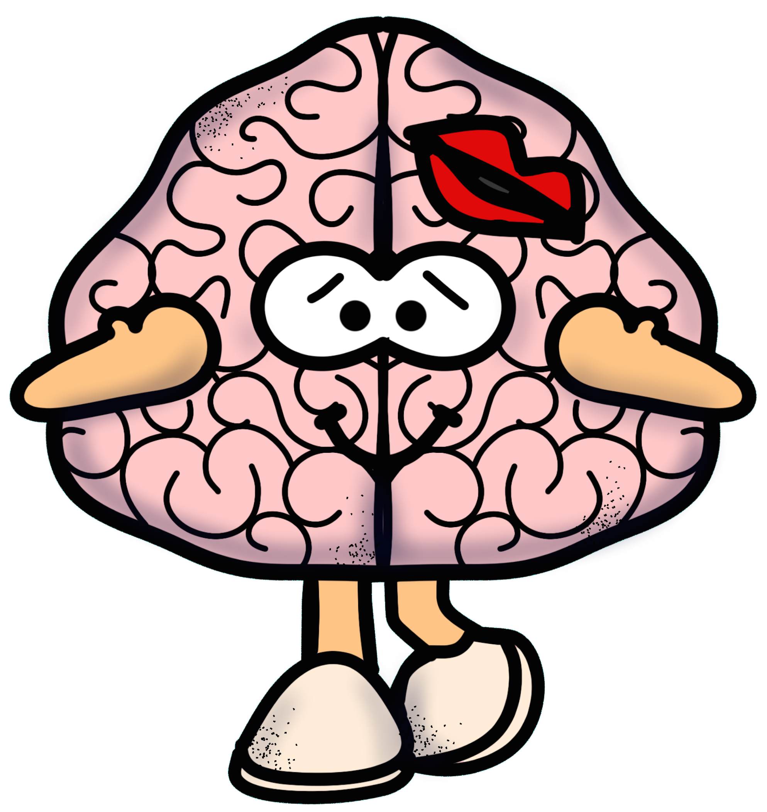
Enhancing Memory:
When information is presented using both words and visuals, it creates two pathways in memory; dual representation.
If one pathway is forgotten, the other can act as a reminder or an alternate cue, increasing the likelihood of recall.
This dual pathway makes memories more resilient and accessible over time.

Slide 5
Reducing Cognitive Load
It simplifies complex information through visuals. Visuals break down concepts, provide clarity, and replace dense text, making ideas easier to grasp and reducing mental effort.
They also focus attention on key points and minimize the need for mental translation.
Understanding, retention, and recall of information is more efficient.

Slide 6
Practical Application:
Dual coding can be implemented in various ways, such as:
Using diagrams, charts, or icons alongside text to illustrate key points.
Creating visual summaries or mind maps.
Encouraging students to draw pictures or diagrams to represent verbal concepts.

Slide 7
Diagrams:
Combine visual with labels, or descriptions.
These can be as activities, or as part of presentations.

Slide 8
Timelines and Storyboards:
Show events in chronological order with clear start/end points.
Or
Arrange frames in a logical sequence to outline stories or processes.
Both tools should focus on clear layouts, concise content, and visuals for effective communication.

Slide 9
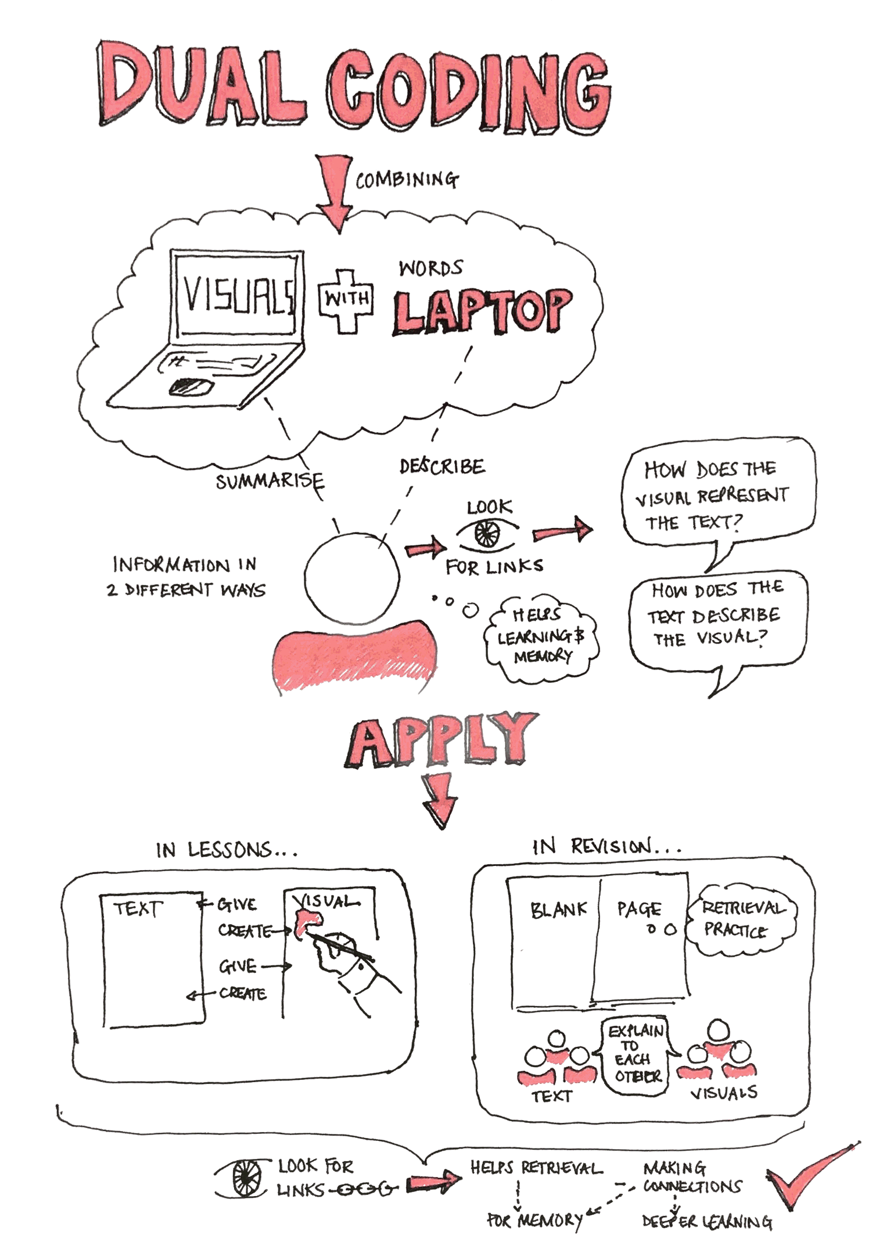
Infographics:
A good infographic effectively communicates complex information quickly and clearly using:
Focused Content
Eye-catching Design
Visuals
Readable Typography
Engaging Flow

Slide 10
This is a mind map as a topic revision activity:
Mind Maps
A good mind map should:
Central Idea: Start with a clear central topic in the middle.
Main Branches: Use thick, colour-coded lines for key categories.
Sub-Branches: Break down into thinner lines with short labels.
I’m sorry, I drew this in about 2011
Visual Elements: Add icons, images, and colour to enhance memory.
Clarity: Keep it spacious, easy to read, and logically organized.

Slide 11
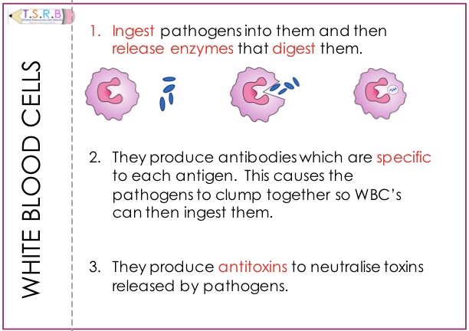
Flashcards:
Flashcards are a powerful tool for active recall and spaced repetition, making them ideal for studying concepts, vocabulary, or facts.
Key Features of Effective Flashcards:
  Use short questions or prompts on the front.
  Provide brief, clear answers on the back.
  Focus on one concept per card to avoid information overload.

Slide 12
Summary
Dual coding leverages the brain’s ability to process images and words separately, creating a more robust and versatile memory system.
It supports effective learning and retention.

Slide 13

Useful Links:
Learning Scientists
Science Direct
@Gina Davies

