Slide 1
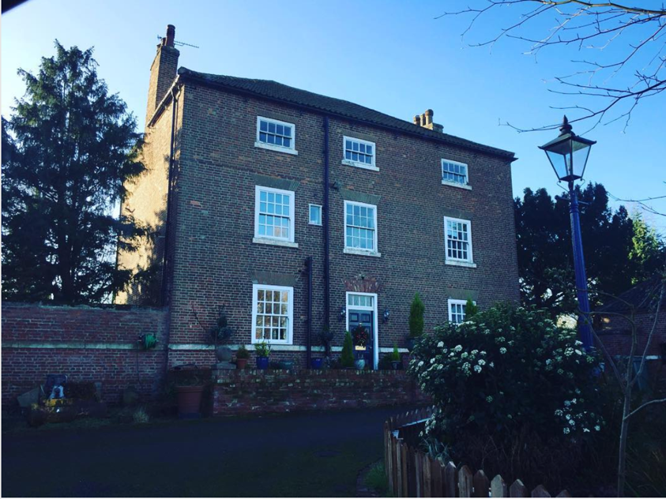
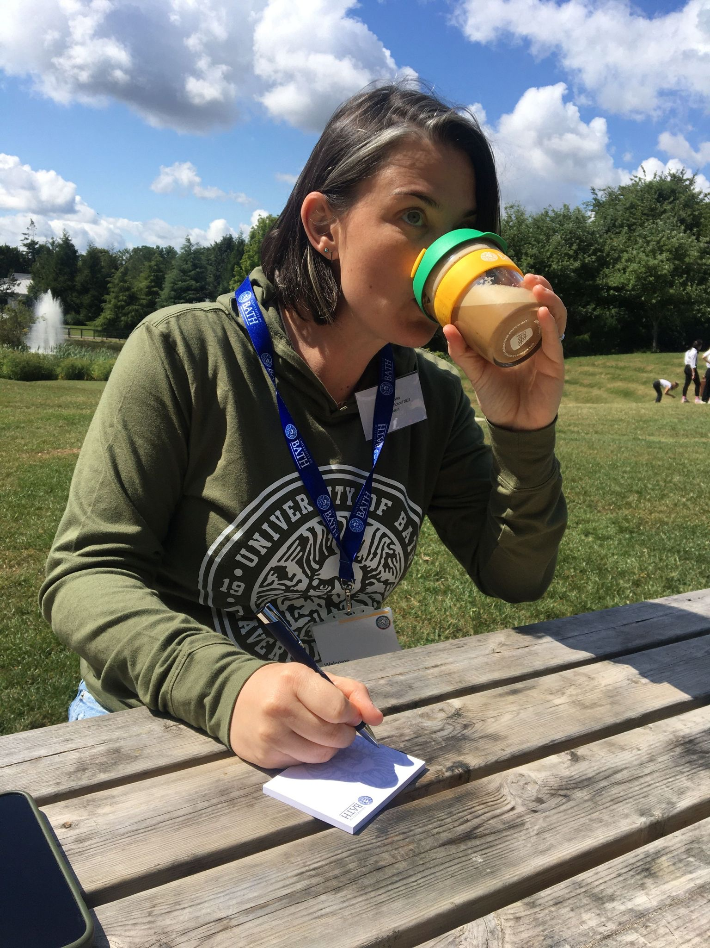
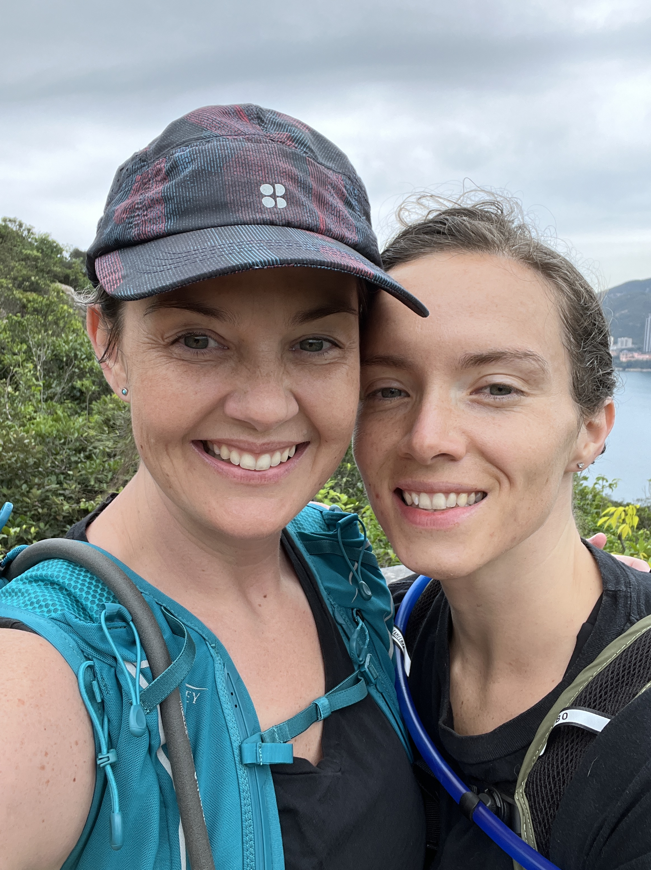
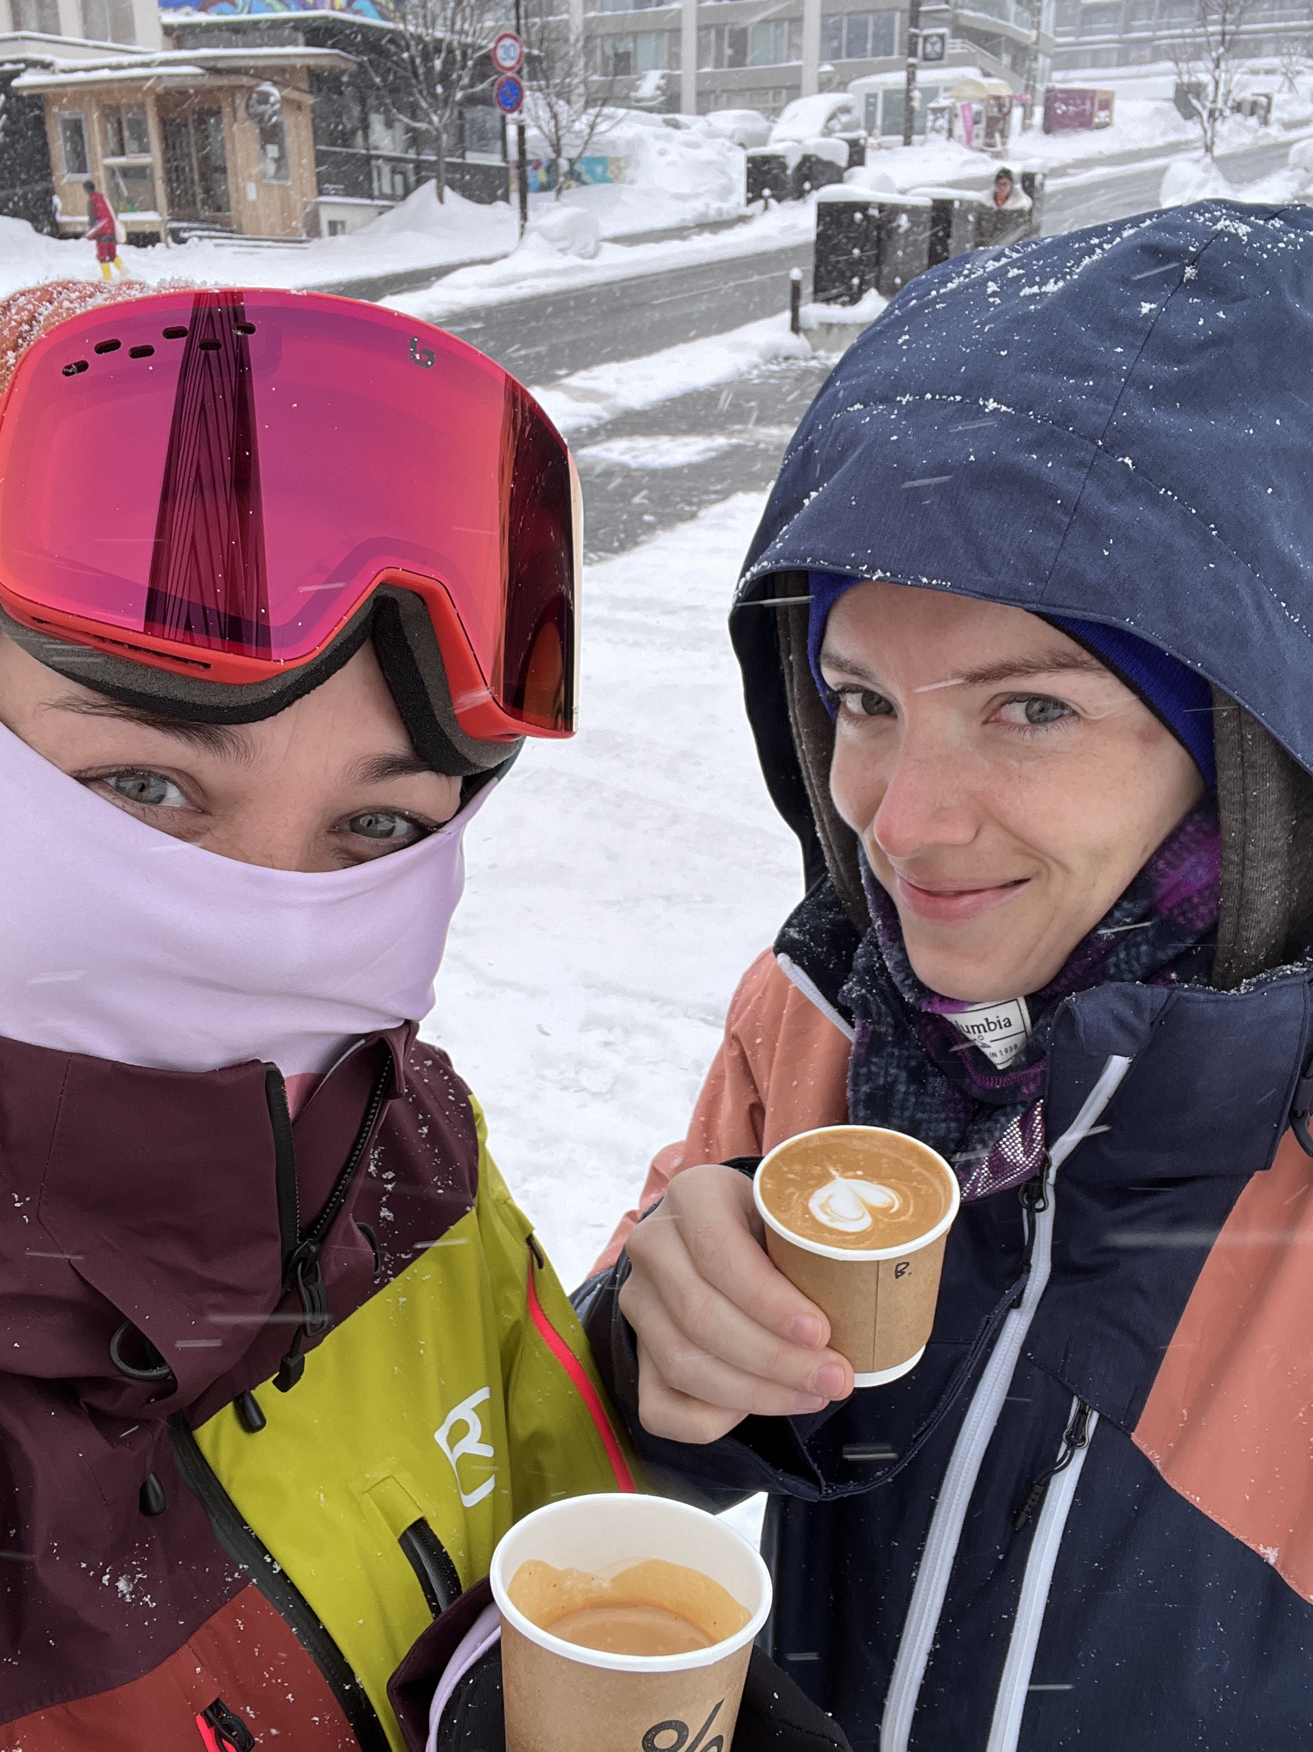
Blyth
Notes:
Guiding Questions that might help you formulate your own storyboard...
Where are you from?
What’s been the highlight of your career/life journey so far?
What makes you the person you are today?
Who what has helped shaped your journey?
Is there one person you are incredibly grateful for?
What challenges have you faced along the way?
Where have you failed? What did you learn?

