Slide 1
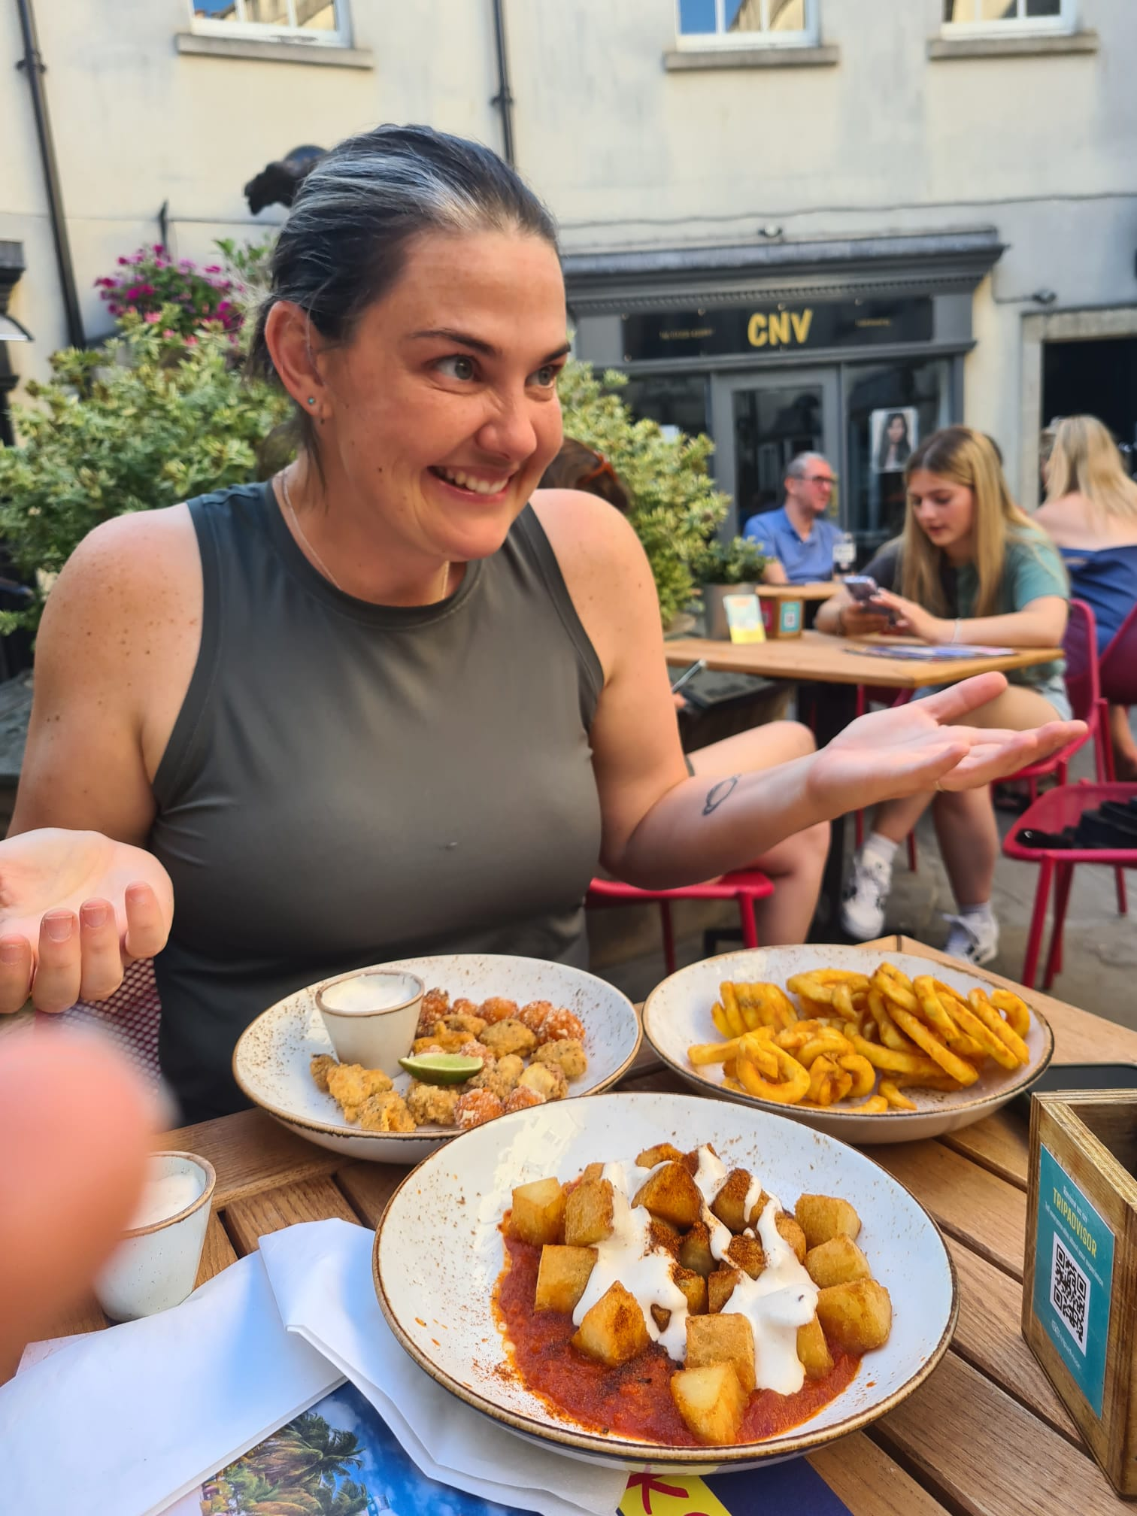
Gina’s User Guide
Ingredients:
Leadership Compass: South-West (Empathy-Analytical)
MBTI: INFJ-T (The Advocate)
CliftonStrengths 34:
1. Connectedness 2. Developer 3. Includer 4. Positivity 5. Learner
Values: Integrity, Fairness, Honesty, Altruism, Belonging.
~ Gina struggles in situations which are in opposition to her values.
Gina entered the world to the sound of Culture Club in the Autumn of 1983. She comes with a spouse and a dog.
LinkedIn hosts a bit more professional information and you can request to see her CV.
North Stars: Gina loves the work of Brené Brown and Simon Sinek.
Recipe for Success: Communication:
She’s up and running by 5 am, but come 9 pm, she’s usually in snooze mode (unless she’s on holiday, in which case, she becomes a creature of the night).
When it comes to work communication she has her preferences: In-person is her top pick, followed by Email, and then all those techy platforms like Slack and WeChat. Don’t ever feel like you can’t message to ask questions based on your own preferences though.
She’s quite the fan of walking and talking. Suggest a rendezvous in the great outdoors, under the (not always so) gentle rays of the sun, and you’ll have her bouncing ideas around with the giddiness of a child.
For meetings, just slot them into her calendar when she’s free. Provide a time and place, and trust that she’ll show up. If it’s a weekend, she’s probably in Hong Kong, so send her an instant message or wait for her to check her email on Sunday afternoon.
Conversation: Gina likes a good conversation, especially when it’s about education, non-fiction books, scrumptious food, and good coffee. Ask her what’s on her reading list, trade recommendations, and guide her to the good food and coffee spots; she requires coffee to function, eats anything and everything and doesn’t need to be hungry to eat!
When it comes to chat, she’s all about authenticity. Skip the small talk and dive into real, meaningful discussions. And don’t be shy to challenge her thoughts – she enjoys a good mental workout. She wants to get to know you but will generally avoid asking personal questions as she'll feel she's being intrusive. She'll answer any questions you have freely.
Feedback:
Gina prefers her feedback served explicitly with a core of kindness and a direct approach, just the way she likes to dish it out. If you’ve got different preferences, let her know, and she’ll do her very best to accommodate.
She’s your personal cheerleader, fully dedicated to your success and really wants what is best for you. Tell her how she can step up in supporting you, and remember, mutual accountability is the name of the game. It’s really important to her that you feel a sense of belonging and know how much she values you.
Positive feedback tends to make her a tad awkward, she’s likely to either ignore it completely or deflect it with a well-timed dose of humour. After all, laughter is the best medicine, isn’t it? Constructive feedback that leads to improvement is more her cup of tea.
Cautionary Warnings:
Gina is the ultimate question-asker, not because she doesn’t trust you, but because her curiosity knows no bounds! She’s trying to gather all the info to do her job well. She’s an over-thinker champ and so if there’s a gap, she’ll invent stories to fill it. She’s aware it’s not always helpful but just can’t help herself!
Gina’s a details person with curriculum and is your go-to girl for planning and organisation. If things go haywire or there are significant gaps in that department, be forthcoming about it (she’s probably seen it anyway) and she’ll always help where she can.
She’ll likely be a little upset if you aren’t transparent and honest about mistakes, she knows mistakes are part of life, but thinks we should own them. She will never be upset when you make an honest mistake and will likely have a story of her own bigger blunder.
Remember, Gina’s memory is like a sieve – if a task is not on her to-do list, she may completely forget about it. Feel free to give her a gentle nudge when she forgets. She’s also a typo Queen so help her out with a quick heads-up!
Gina is action-oriented and will start to get frustrated if there is excessive talk and not a lot of tangible progress. She wants to get things done, and done well; she also gets frustrated when things are done poorly.

